Slide 1
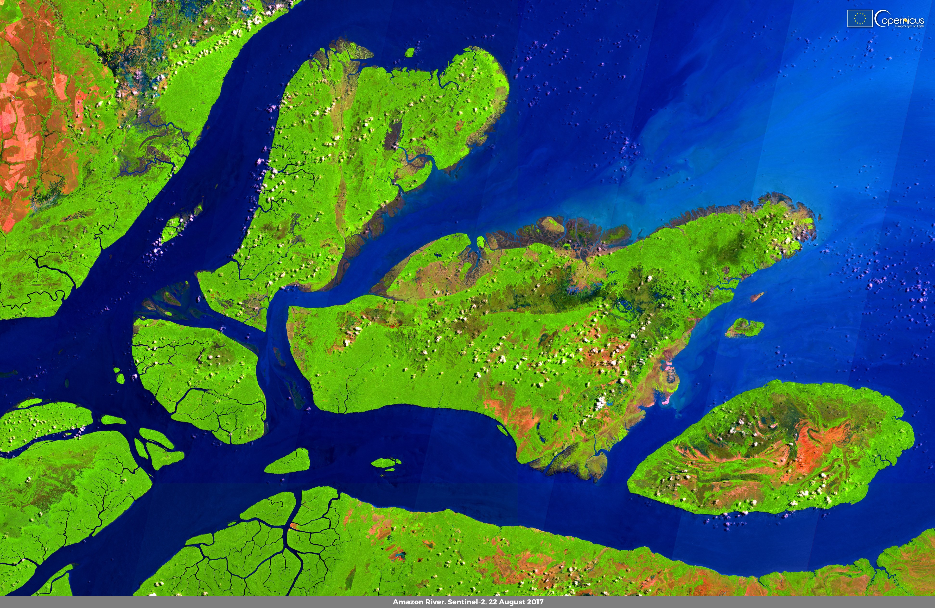












EO4FLOOD
EARTH OBSERVATION FOR
ADVANCING FLOOD FORECASTING
EO dataset for hydrology
Authors: A. Tarpanelli, L. Ciabatta, C. Massari, M. Sadki, O. Elmi, D. Scherer, K. Nielsen, P. Saemian, S. Zaprzala, P. Tamagnone

Slide 2
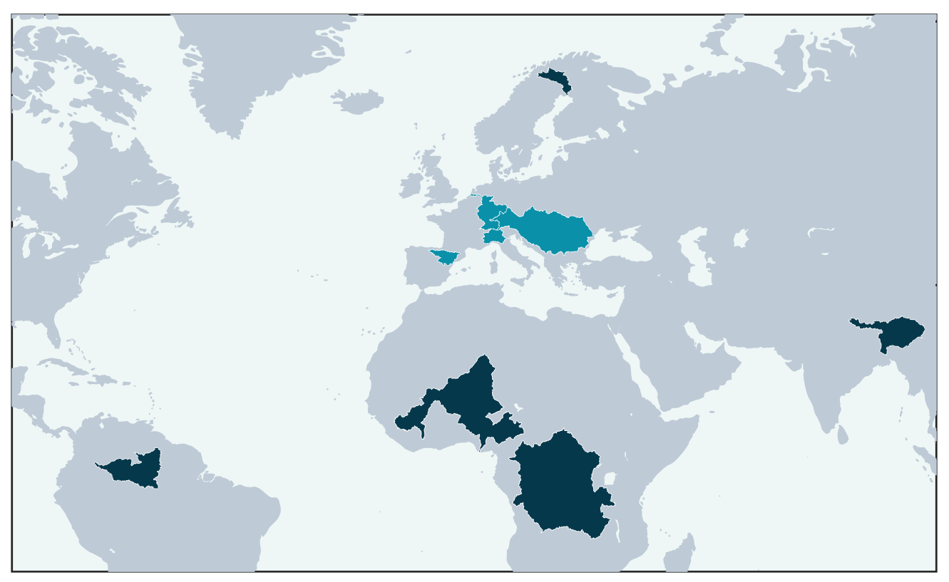
Study Area
Torne
The EO dataset is provided in 9 basins across the world:
Negro
Congo
Niger
Brahmaputra
Torne
Rhine
Danube
Ebro
Po
Rhine
Danube
Ebro
Po
Brahmaputra
Niger
Congo
Negro

Slide 3
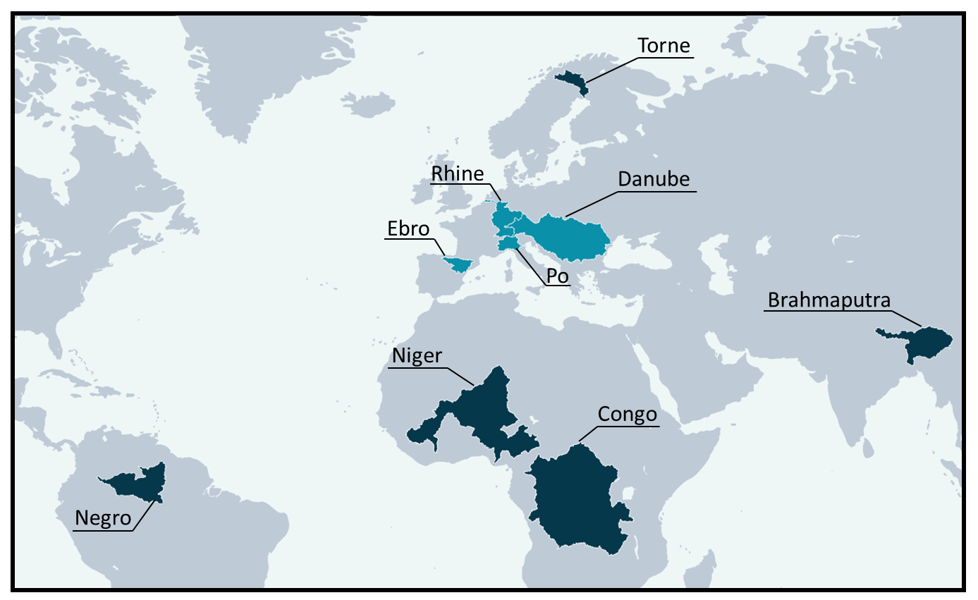
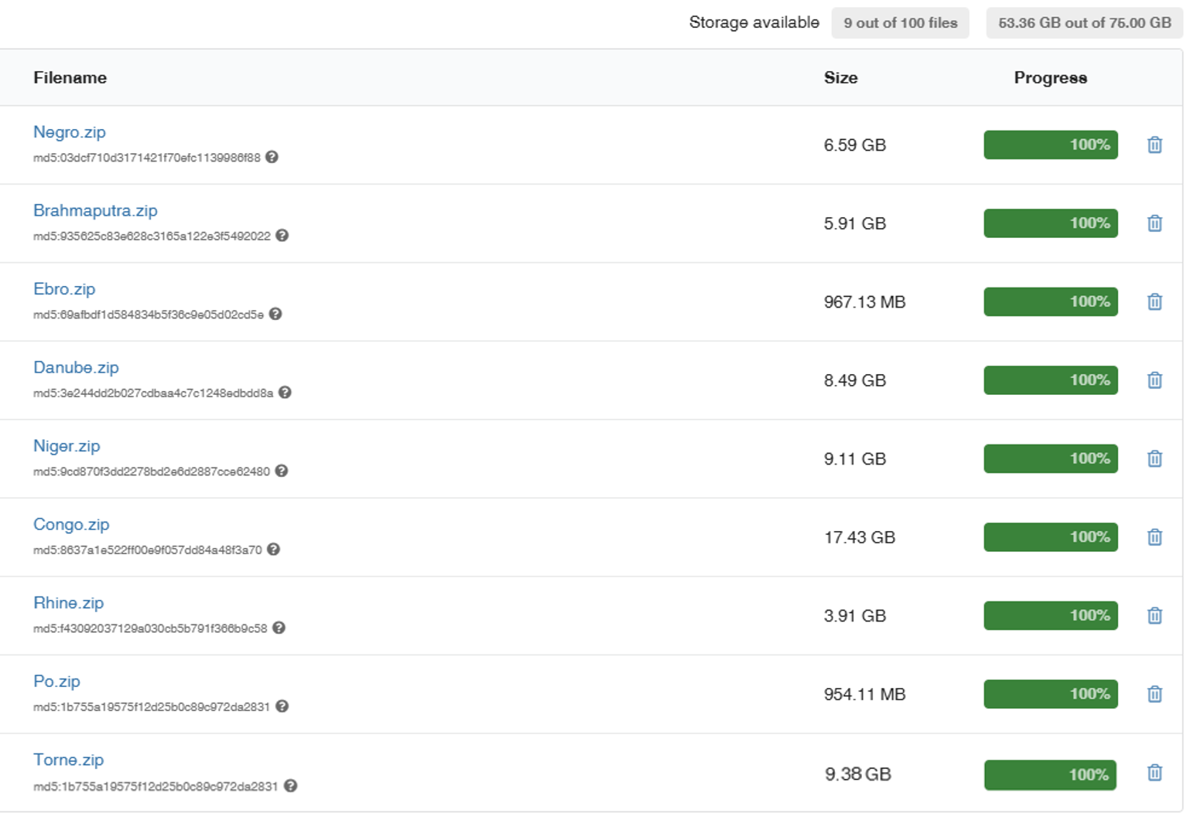
EO dataset repository
DOI: 10.5281/zenodo.17787732
Total of 55 Gb is the actual storage

Slide 4
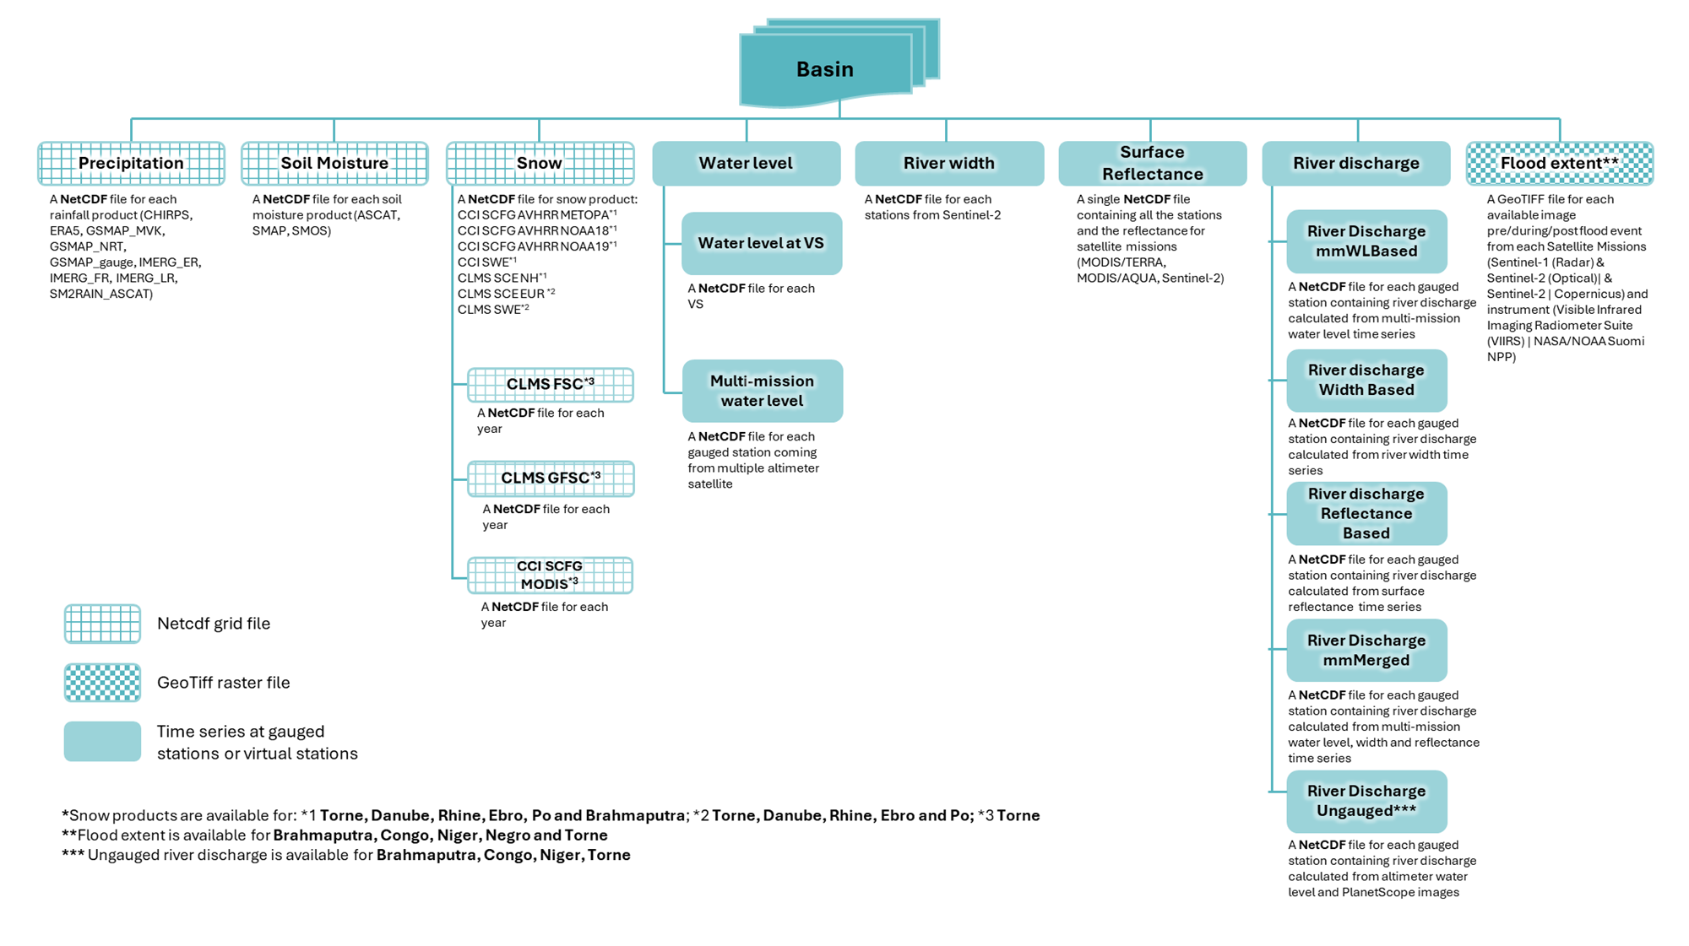
EO dataset scheme

Slide 5
Precipitation
Precipitation product | Temporal sampling | Spatial sampling | Temporal coverage | Status
IMERG-ER | 1 h | 0.1° | 2016-2024 | Delivered
IMERG-LR | 1 h | 0.1° | 2016-2024 | Delivered
IMERG-FR | 1 h | 0.1° | 2016-2024 | Delivered
CHIRPS* | daily | 0.05° | 2016-2024 | Delivered
SM2RAIN_ASCAT | daily | 0.1° | 2016-2024 | Delivered
ERA5-Land | 1 h | 9 km | 2016-2024 | Delivered
GSMAP-NRT* | 1 h | 0.1° | 2016-2024 | Delivered
GSMAP-MVK* | 1 h | 0.1° | 2016-2024 | Delivered
GSMAP-Gauge* | 1 h | 0.1° | 2016-2024 | Delivered
* Not available over Torne River basin

Slide 6
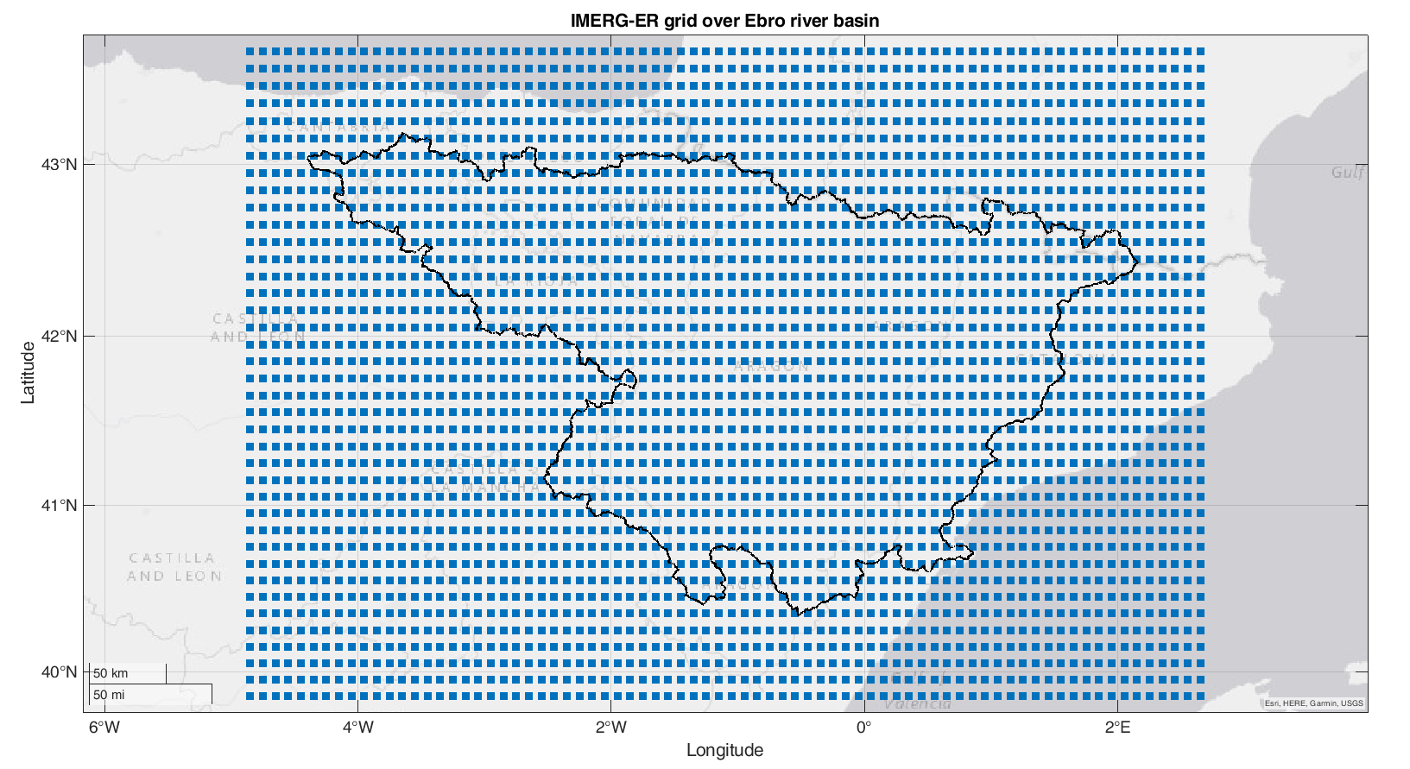
Precipitation
We have consider a buffer of 0.5° wrt the basin boundary to extract the data
We have maintained the native spatial/temporal sampling of each dataset. Only IMERG-derived datasets have been accumulated to 1 hour

Slide 7
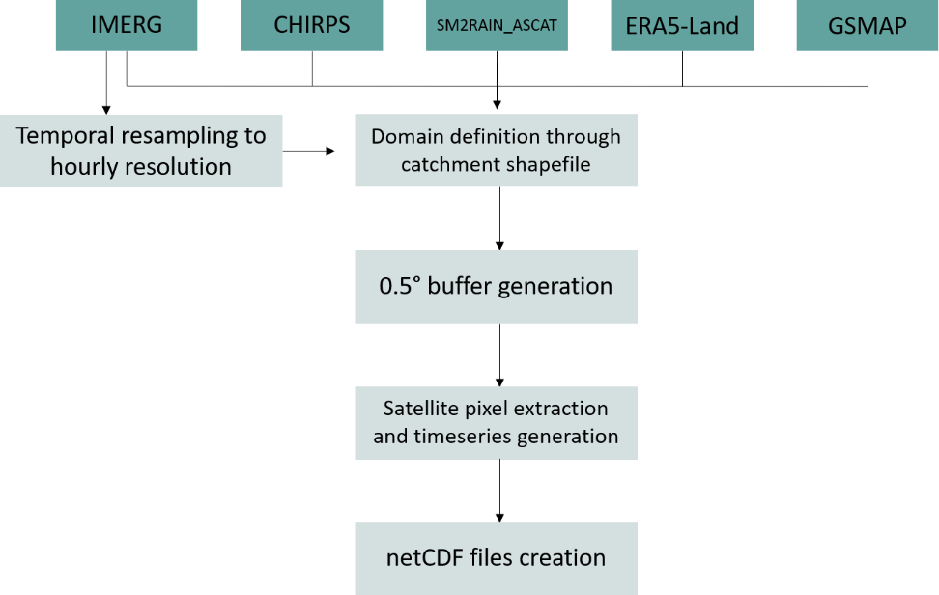
Precipitation

Slide 8
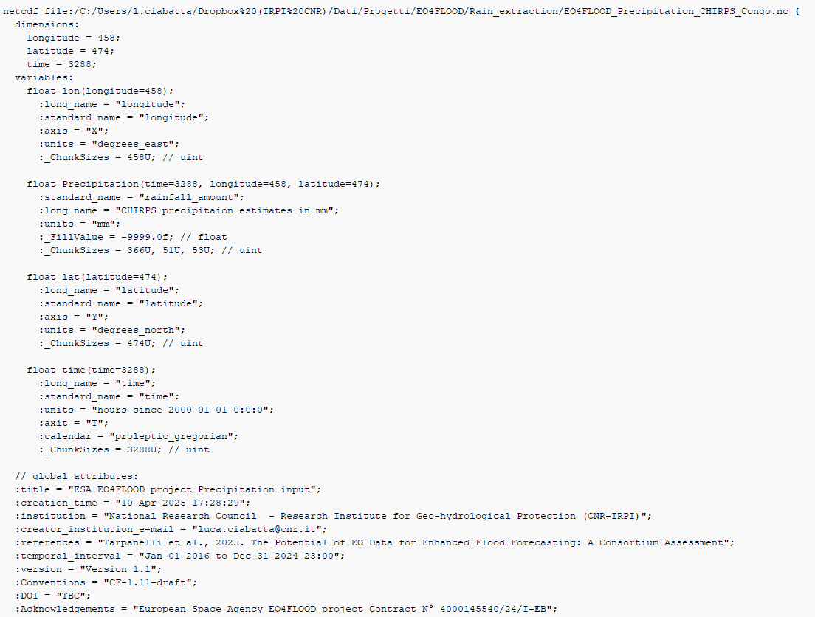
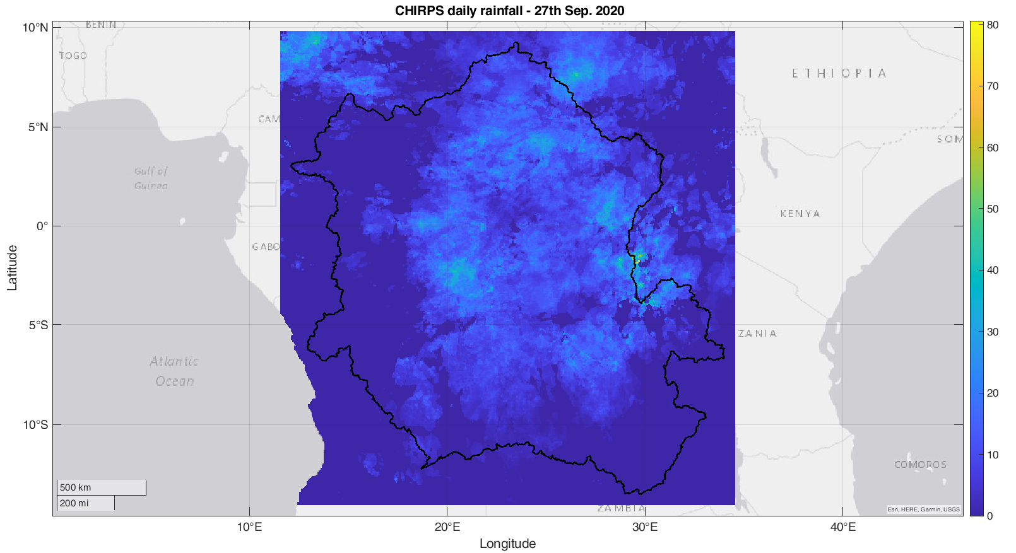
Precipitation

Slide 9
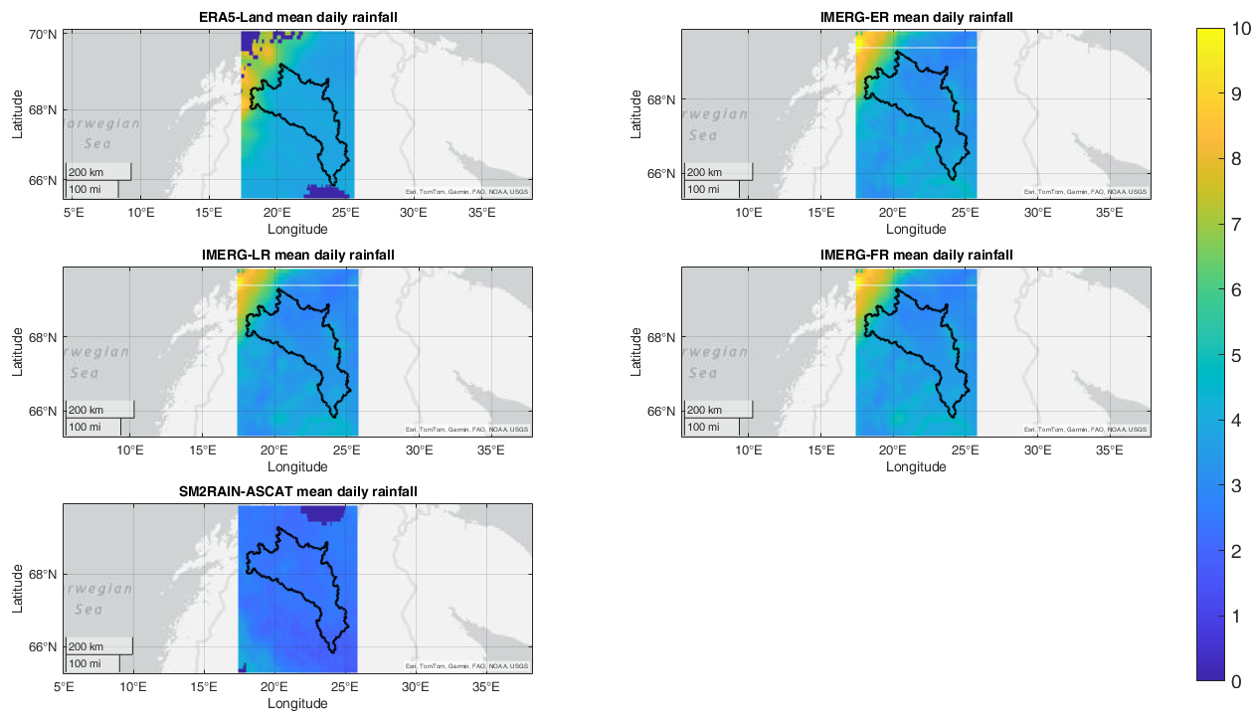
Precipitation
Mean precipitaion over Torne for the entire analysis period
Good agreement between the available products
SM2RAIN-ASCAT underestimate total amount

Slide 10
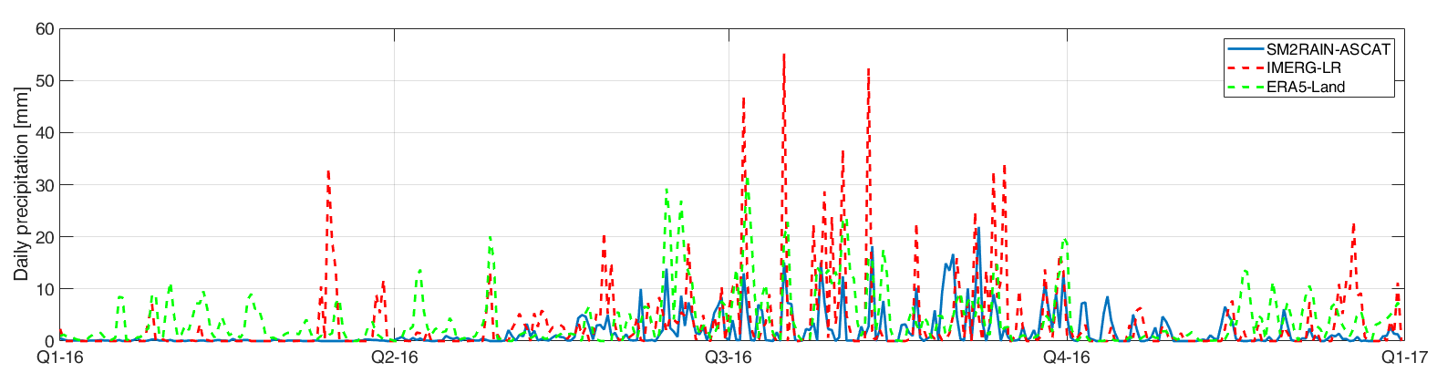
Precipitation
Precipitation time series for one randomly selected pixel over Torne

Slide 11
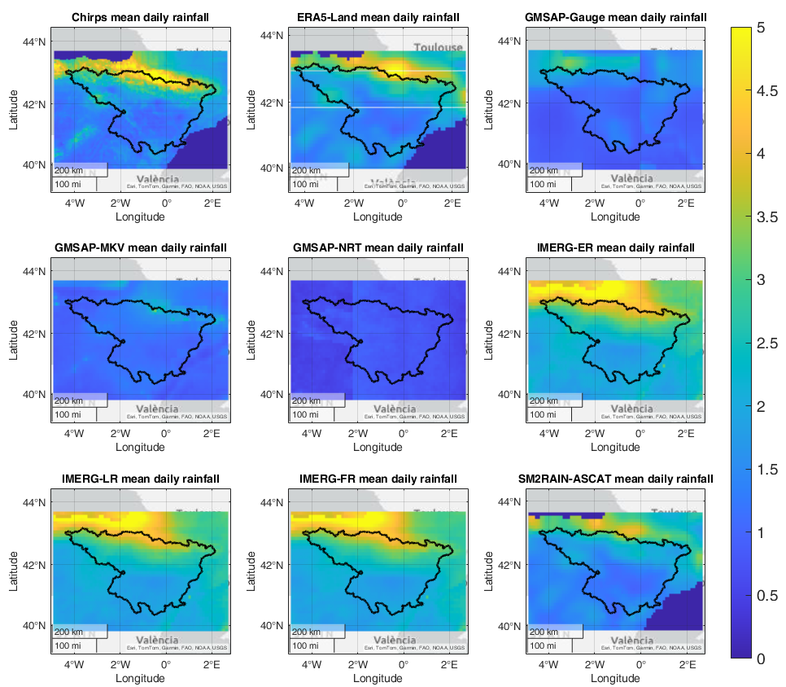
Precipitation
Mean precipitaion over Ebro for the entire analysis period
Good agreement between the available products
SM2RAIN-ASCAT underestimate total amount
GMSAP strongly underestimate total amount

Slide 12
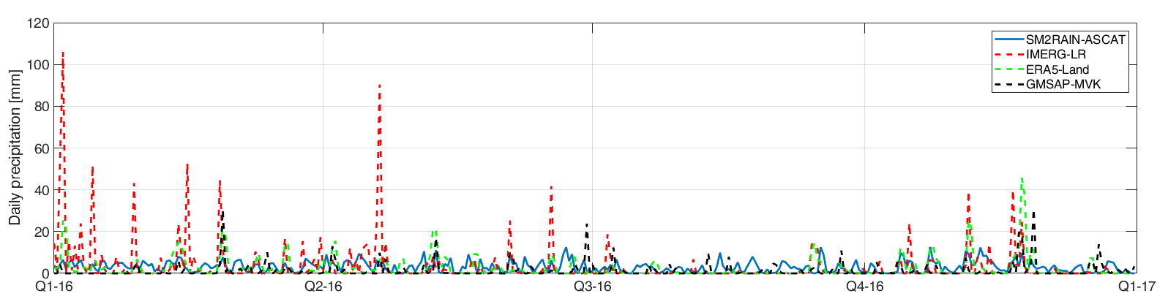
Precipitation
Precipitation time series for one randomly selected pixel over Ebro

Slide 13
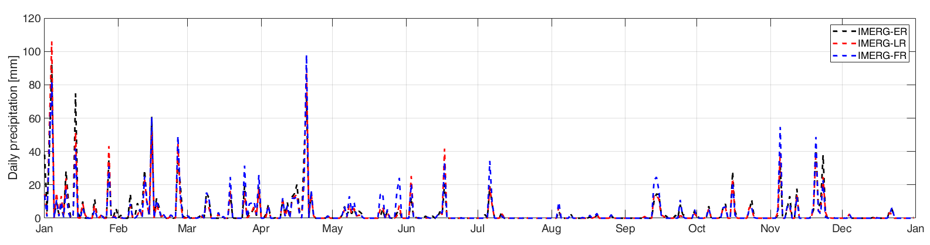
Precipitation
Precipitation time series for one randomly selected pixel over Ebro for IMERG-derived products

Slide 14
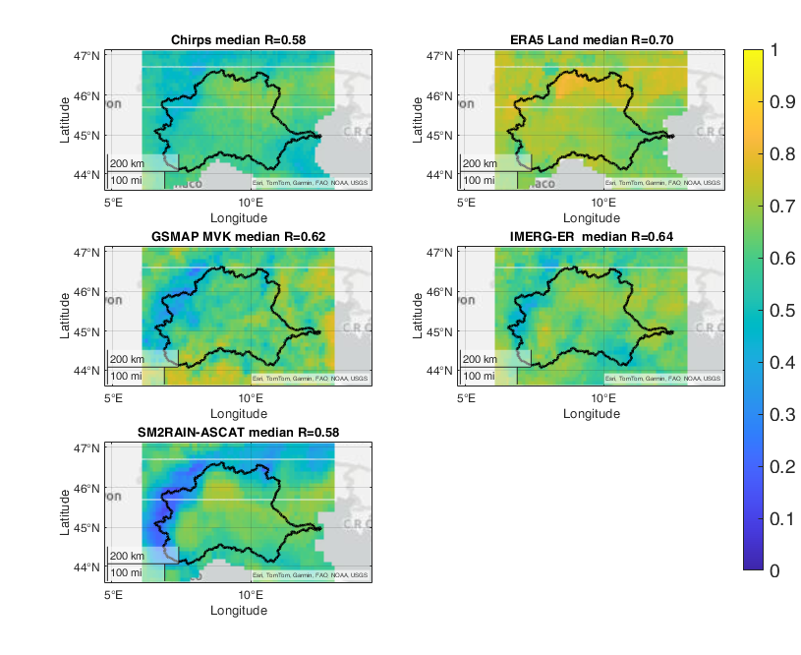
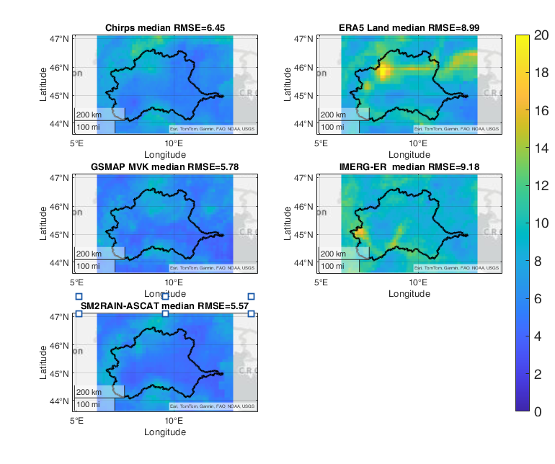
Precipitation
Correlation coefficient (left) and RMSE (right) over PO River basin against MSWEP

Slide 15
Soil Moisture
Soil moisture product | Revisit time | Spatial sampling | Temporal coverage
SMAP L3 | 2-3 days | 36km | 2016-2024
SMOS L3 | 3 days | 25-50km | 2016-2024
ASCAT (H 121) | Daily | 12.5km | 2016-2024
Near real time versions of these products H101, H16, H104, SMOS NRT and SMAP L2 will be considered over operational test case, e.g., Niger. Codes will be provided to read the products directly in the official data archive and emulate the model in hindcast mode.

Slide 16
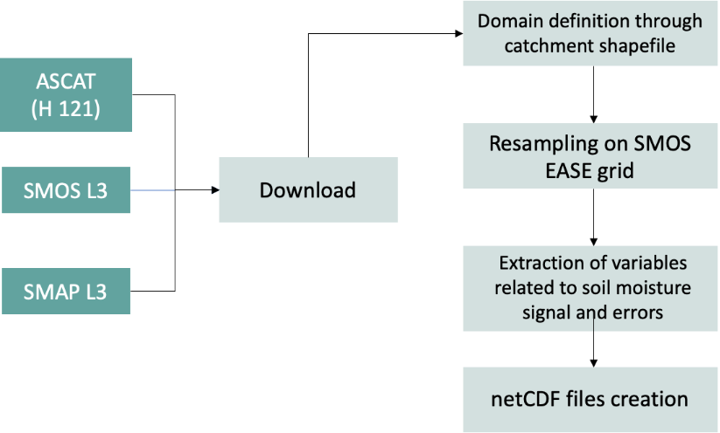
Soil Moisture
https://hsaf.meteoam.it/
https://www.catds.fr/Products/Available-products-from-CEC-SM/CEC-SM-OS
https://nsidc.org/data/smap/data.

Slide 17
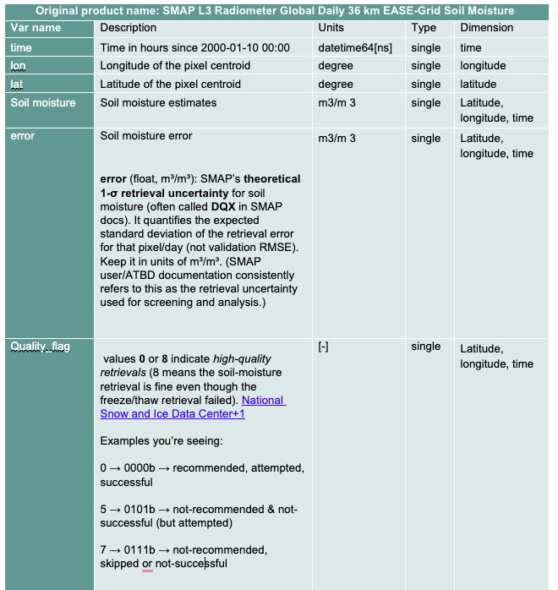
Soil Moisture
Soil moisture nc structure example
Attribute | Description | Units | Type
title | ESA EO4FLOOD project Precipitation input | - | text
creation_time | Time of NetCDF file generation | - | text
institution | Name of institution “National Research Council (CNR)” | - | text
creator_institution_e-mail | Contact information | - | text
references | Project reference paper | - | text
Temporal interval | Time window of the extracted data | - | text
version | File version | - | text
Conventions | CF-1.11-draft | - | text
DOI | Digital Object Identifier | - | text
Acknowledgements | ESA EO4FLOOD project reference | - | text

Slide 18
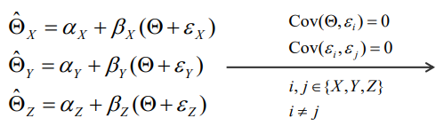
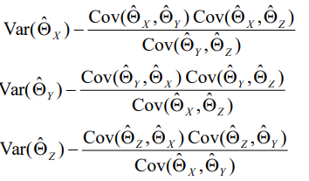
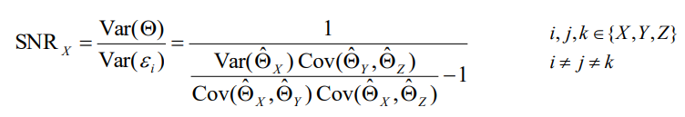

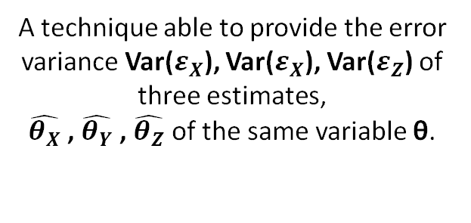
Soil Moisture: error characterization
Strategy:
Comparison against ERA Land soil moisture
Perform Collocation Analysis (Gruber et al. 2016)
A technique able to provide the error variance Var($ε_{X}$), Var($ε_{X}$), Var($ε_{Z}$) of three estimates,
$\hat{θ_{X}}$, $\hat{θ_{Y}}$, $\hat{θ_{Z}}$of the same variable θ.
Assumptions
Error variances
Stofflen (1998)
Recently extended to estimate the Signal-to-Noise Ratio (SNR)

Slide 19
Soil Moisture: Correlation with ERA5 Land

Slide 20
Soil Moisture: RMSE vs ERA5 Land

Slide 21
Soil Moisture: TC error and SNR Danube

Slide 22
Soil Moisture: TC error and SNR Brahm.

Slide 23
Soil Moisture: comparison vs ERA5 Land

Slide 24
Soil Moisture: error for DA

Slide 25
Soil Moisture: product performance

Slide 26
Snow
Snow information types / Data sources
2 types of Snow data
Snow Cover (SC-)
Snow Water Equivalent (SWE)
2 types of data :
Type of Product | Product Name
Snow Cover Extent / Fraction (Optical /SAR observations) | CLMS HR FSC (Fractional Snow Cover)
 | CLMS HR Gap-filled FSC
 | CLMS SCE
 | ESA CCI SCF
Snow Water Equivalent (Processed : models, DA) | CLMS SWE
 | ESA CCI SWE
Extent and Fraction
Amount of water stored in snowpack
--> Complementary hydrological needs between these variables
2 sources :
CLMS (Copernicus Land Monitoring Service) --> Operational, HR, NRT, Europe/NH
ESA CCI (Climate Change Initiative) --> Long-Term climate datasets, Global

Slide 27
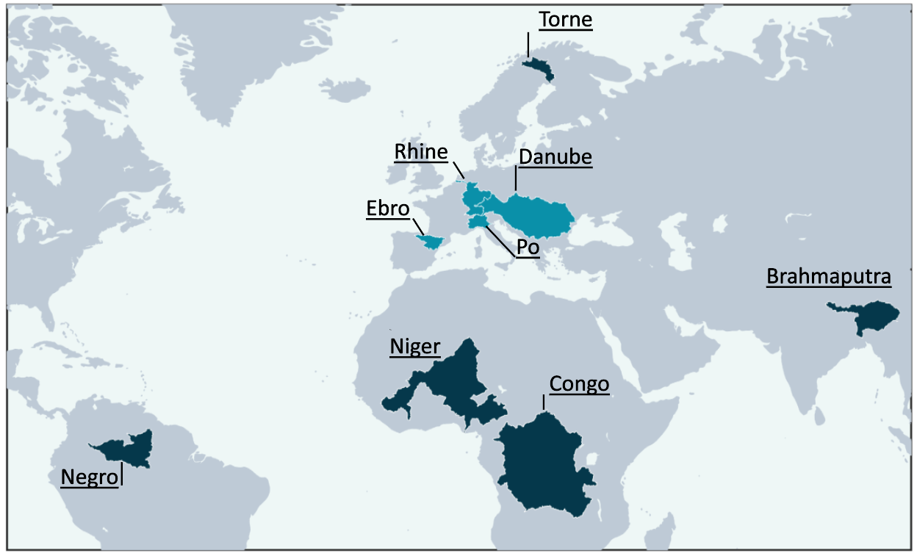
Snow
Snow data – Geographical extent
Type of Product | Product Name
Snow Cover Extent / Fraction | CLMS HR FSC
 | CLMS HR Gap-filled FSC
 | CLMS SCE
 | CCI SCF (SCFG)
Snow Water Equivalent | CLMS SWE (35°N-)
 | CCI SWE
2 products
SCE | EU
 | NH (25°N-)
4 products
CCI SCFG | MODIS
 | AVHRR Metop A
 | AVHRR NOAA 18
 | AVHRR NOAA 19

Slide 28
Snow
Products Portfolio
Type of Product | Product Name | Spatial sampling | Temporal coverage | Temporal resolution
Snow Cover Extent / Fraction | CLMS HR FSC | 20 m | Sept. 2016 - Present | 5 day revisit
 | CLMS HR Gap-filled FSC | 60 m |  | Daily
 | 2x CLMS SCE | 1 km | Jan 2018 - Present
 | 4 x CCI SCF | 1 km (MODIS, AATSR) 5 km (AVHRR) | 1979–2022
Snow Water Equivalent | CLMS SWE | 5 km | 2006 - Present
 | CCI SWE | 0.1° | 1979 - May 2022

Slide 29
Snow
Products Portfolio – Notes, Limitations
Type of Product | Product Name | Spatial sampling
Snow Cover Extent / Fraction | CLMS HR FSC | 20 m
 | CLMS HR Gap-filled FSC | 60 m
 | 2x CLMS SCE | 1 km
 | 4x CCI SCF | 1 km (MODIS, AATSR) 5 km (AVHRR)
Snow Water Equivalent | CLMS SWE | 5 km
 | CCI SWE | 0.1°
Notes / Limitations
From Sentinel-2 (optical) - Cloud/sun limitations in winter period; temporal discontinuities; Corrections for vegetation effects
Combines S2 observations (& S1 SAR wet snow information over mountain areas); Assumes 7-day obs. consistency
Cloud/sun limitations; misclassification in forests possible
Optical sensors ; Long-term data, forest canopy limits visibility (reduced detectability and underestimation of snow fraction)
Good local accumulation representation
Historical data; mountainous regions may have lower reliability

Slide 30
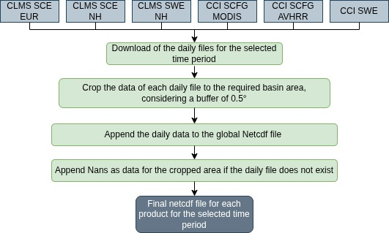
Snow
Data Processing & harmonisation workflow
Type of Product | Product Name | Spatial sampling
Snow Cover Extent / Fraction | CLMS HR FSC | 20 m
 | CLMS HR Gap-filled FSC | 60 m
 | 2x CLMS SCE | 1 km
 | 4x CCI SCF | 1 km (MODIS, AATSR) 5 km (AVHRR)
Snow Water Equivalent | CLMS SWE | 5 km
 | CCI SWE | 0.1°

Slide 31
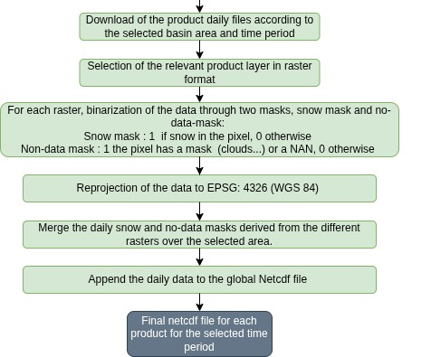
Snow
Data Processing & harmonisation workflow
Type of Product | Product Name | Spatial sampling
Snow Cover Extent / Fraction | CLMS HR FSC | 20 m
 | CLMS HR Gap-filled FSC | 60 m
 | 2x CLMS SCE | 1 km
 | 4x CCI SCF | 1 km (MODIS, AATSR) 5 km (AVHRR)
Snow Water Equivalent | CLMS SWE | 5 km
 | CCI SWE | 0.1°
CLMS FSC / GFSC

Slide 32
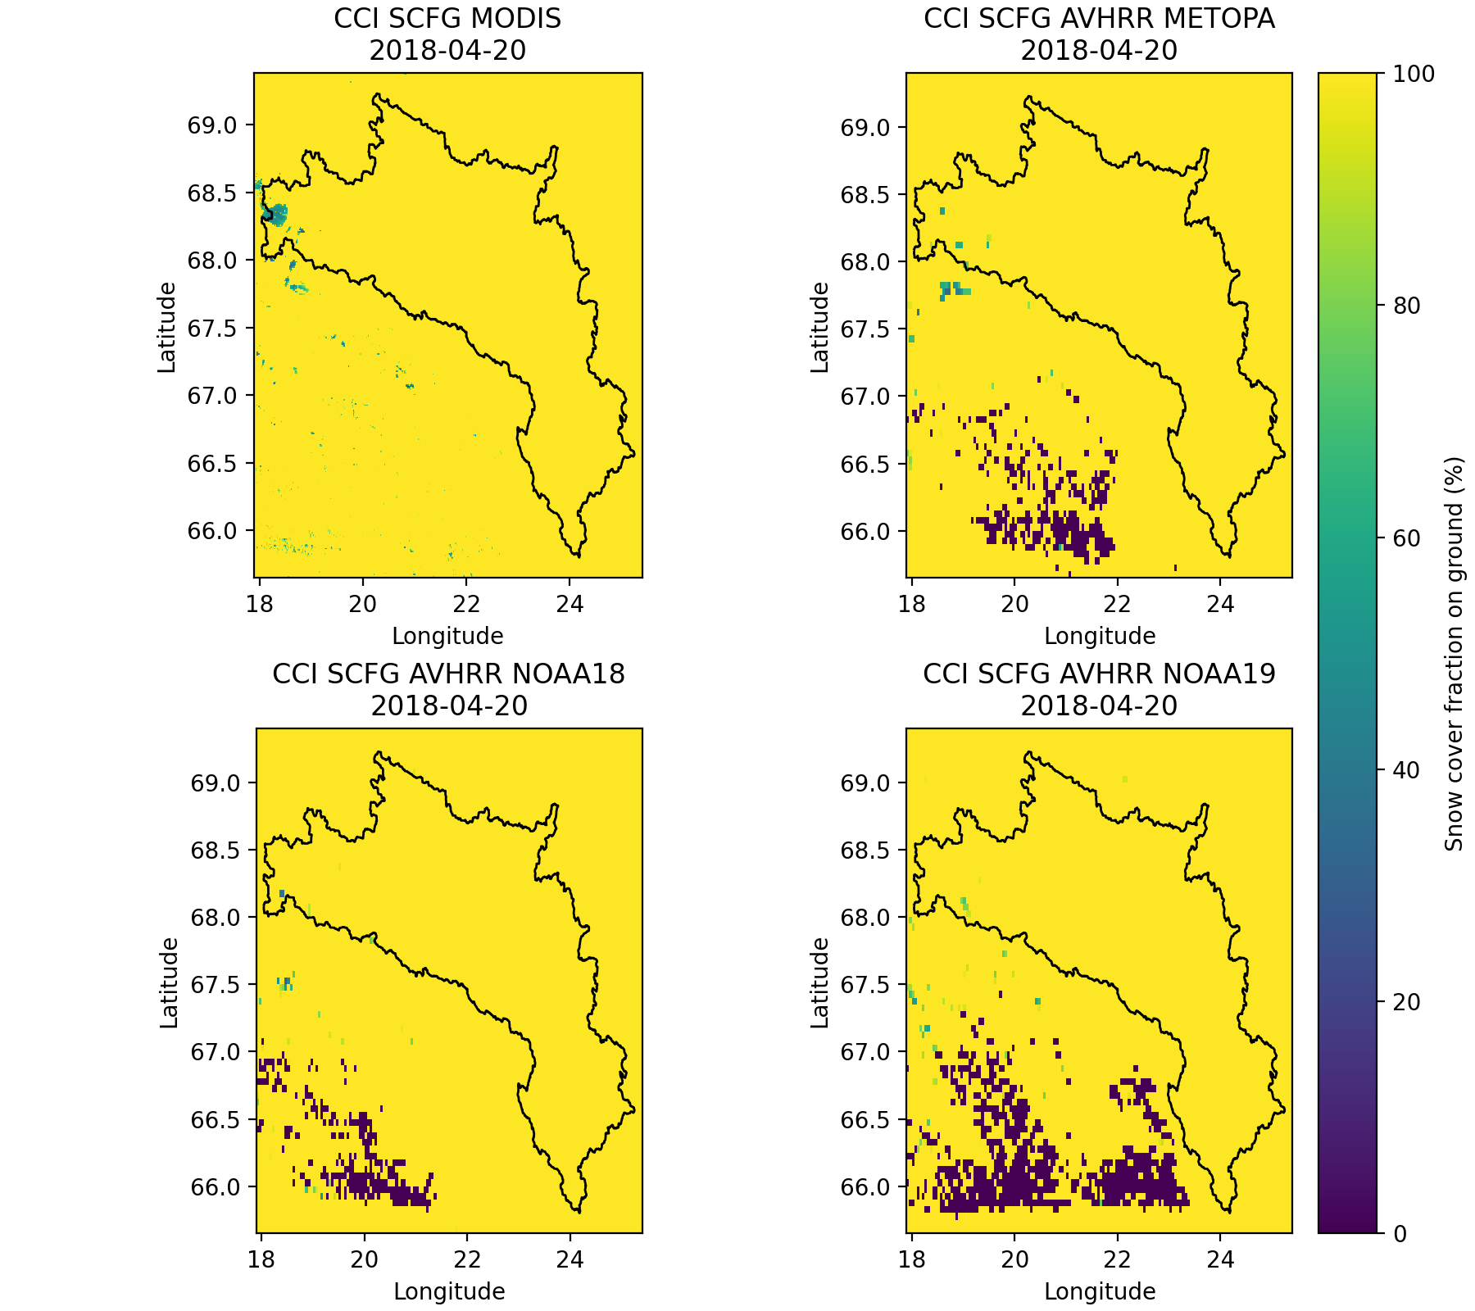
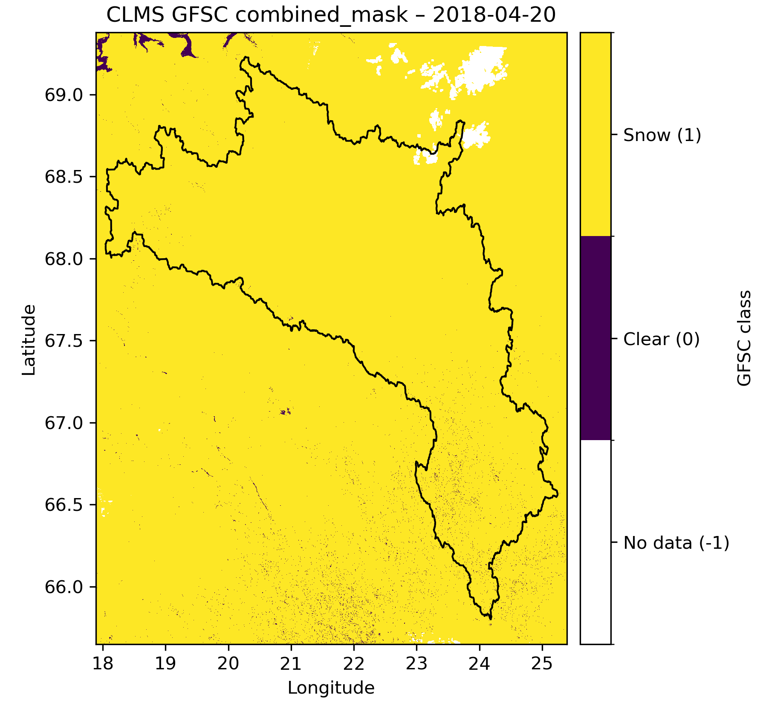
Snow
Products Portfolio – Snow Cover Fraction : Torne Basin
Differences between CCI and CLMS SCF products :
CLMS SCFG : HR, more spatial details; Can capture patchy SC, small-scale variability
(local-scale accuracy)
ESA CCI SCF : smoothed out (coarser res.), more homogeneous
(designed for long-term consistency)

Slide 33
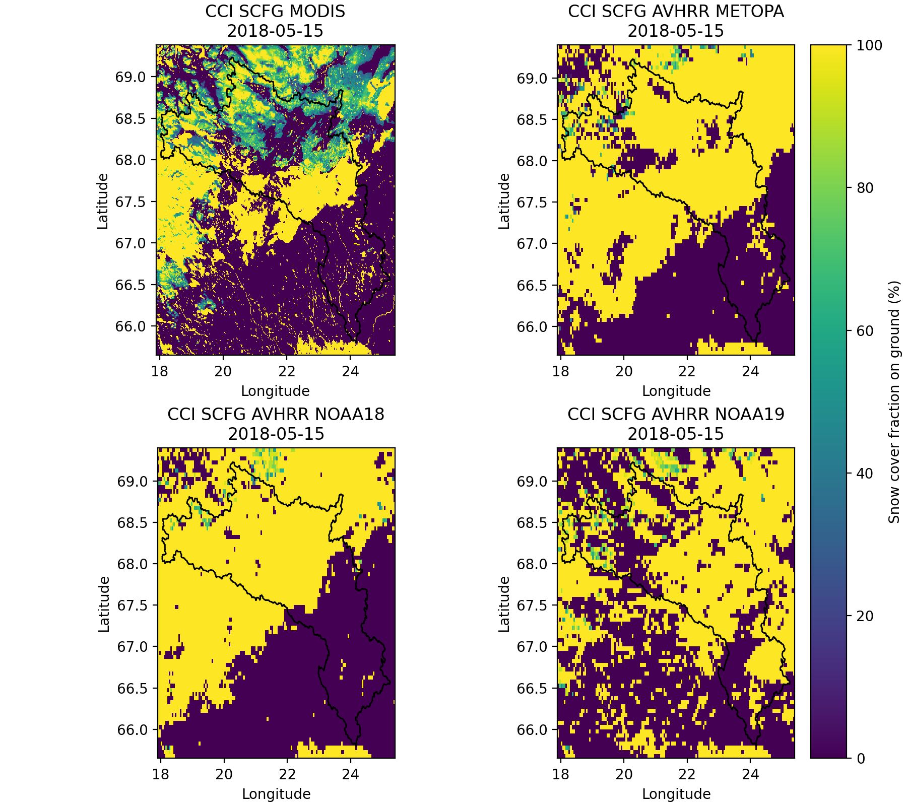
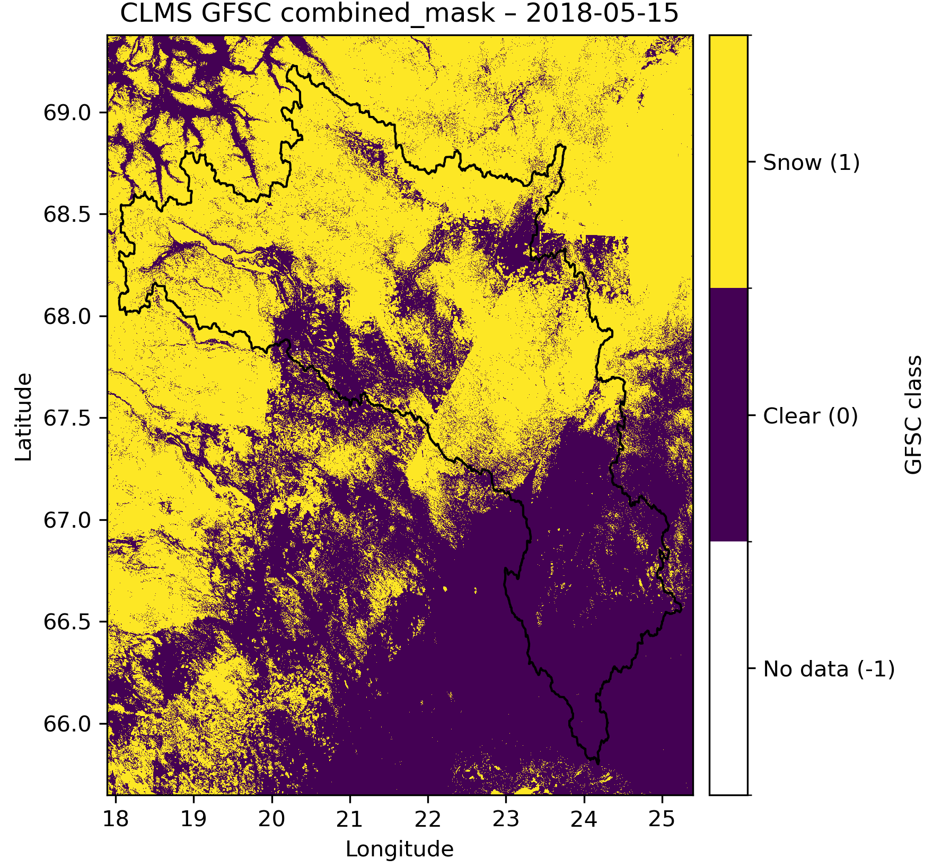
Snow
Products Portfolio – Snow Cover Fraction : Torne Basin
CLMS SCFG : show higher SCF in forested or mountainous areas (canopy corrections)
ESA CCI SCF : Reduced snow detectability under canopy for optical sensors
--> underestimation of SCF

Slide 34
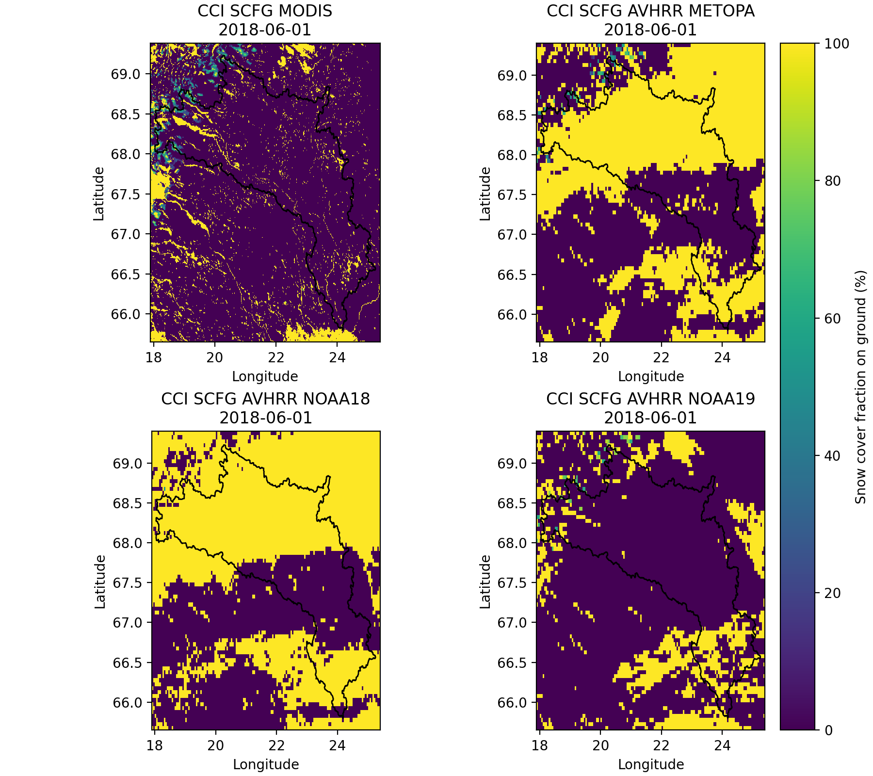
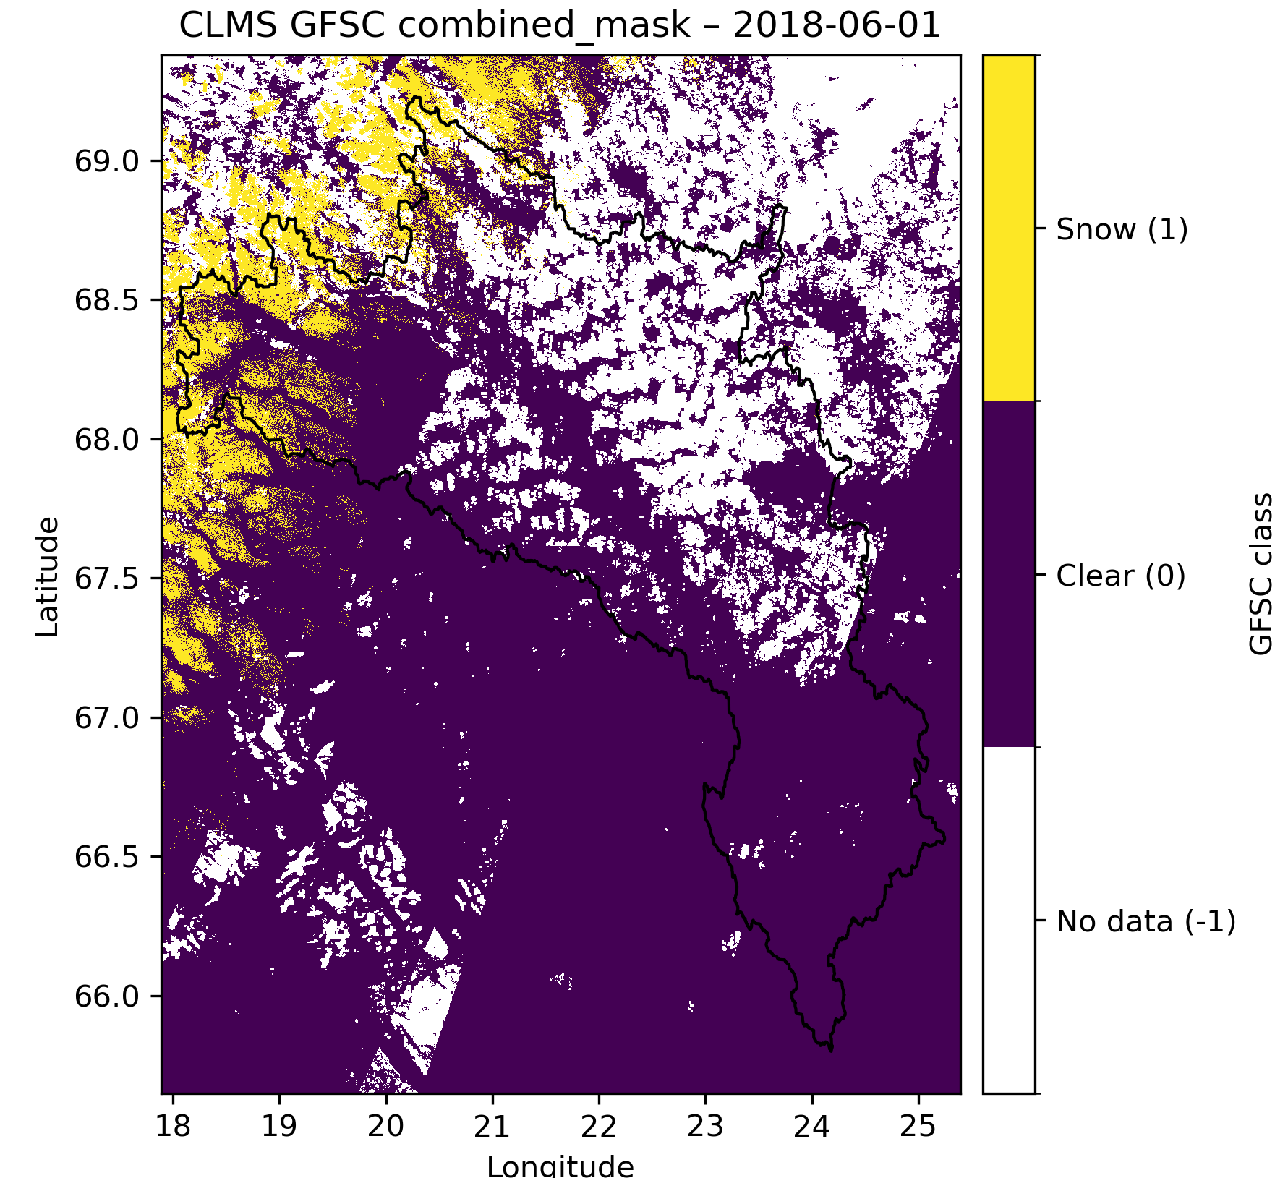
Snow
Products Portfolio – Snow Cover Fraction : Torne Basin

Slide 35
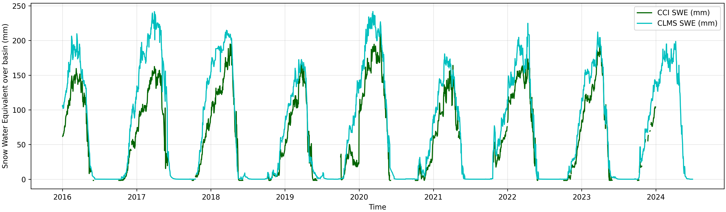
Snow
Products Portfolio – Snow Water Equivalent
Temporal behaviour : Torne Basin
Snow Water Equivalent | CLMS SWE | 5 km
 | CCI SWE | 0.1°
Consistent seasonal cycle and timing (accumulation, melt) between the two products
CLMS SWE – more reactive (event-scale accuracy), represent local accumulation more realistically
--> higher peak accumulation. Continuous daily data.
CCI SWE – designed for long-term consistency + coarse spatial resolution :
Spatial smoothing of snow accumulation (orographic effects smoothed between high-elevation zones and lower-altitude pixels).

Slide 36
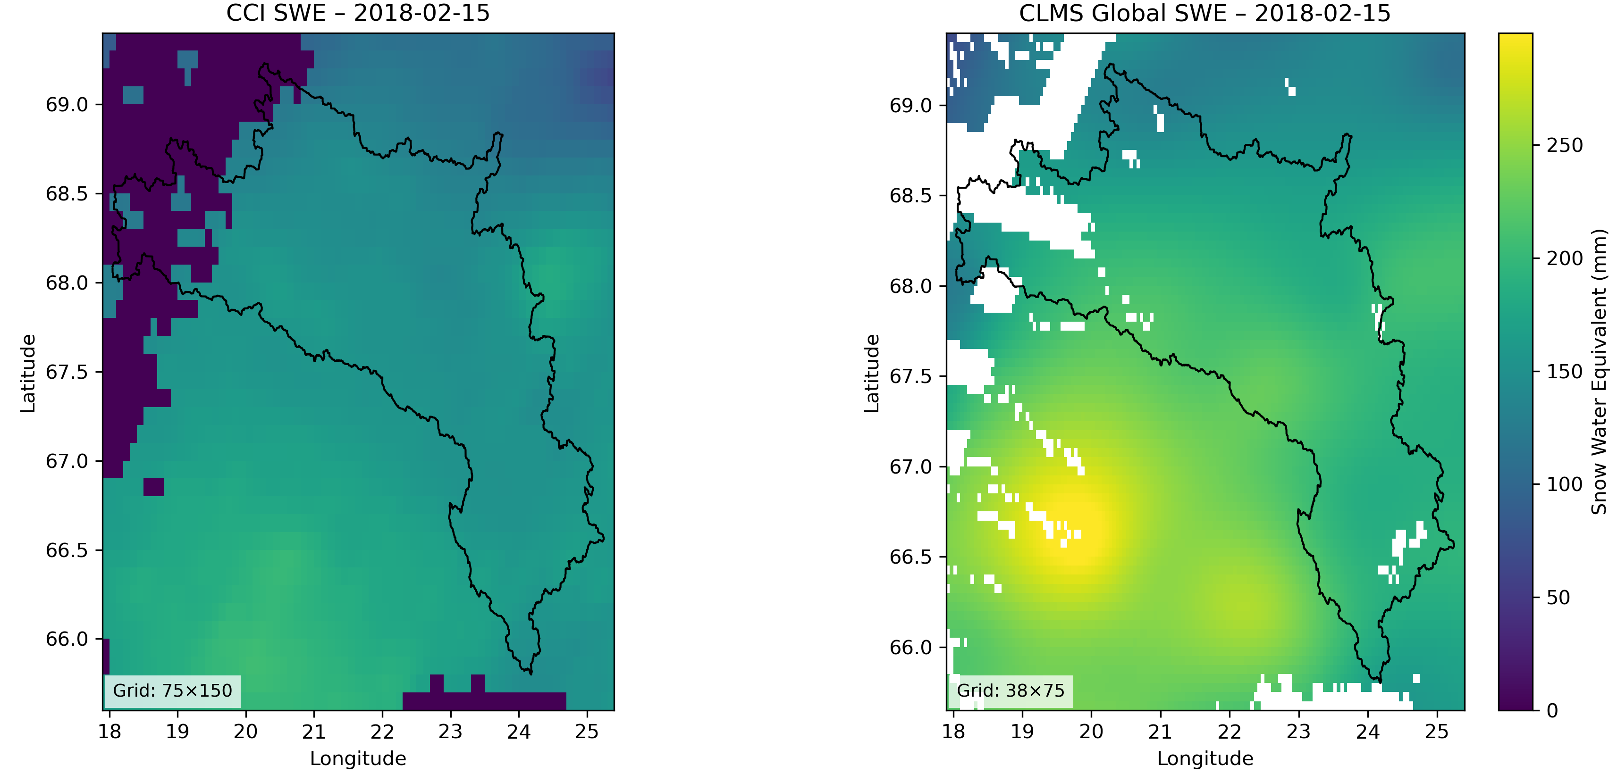
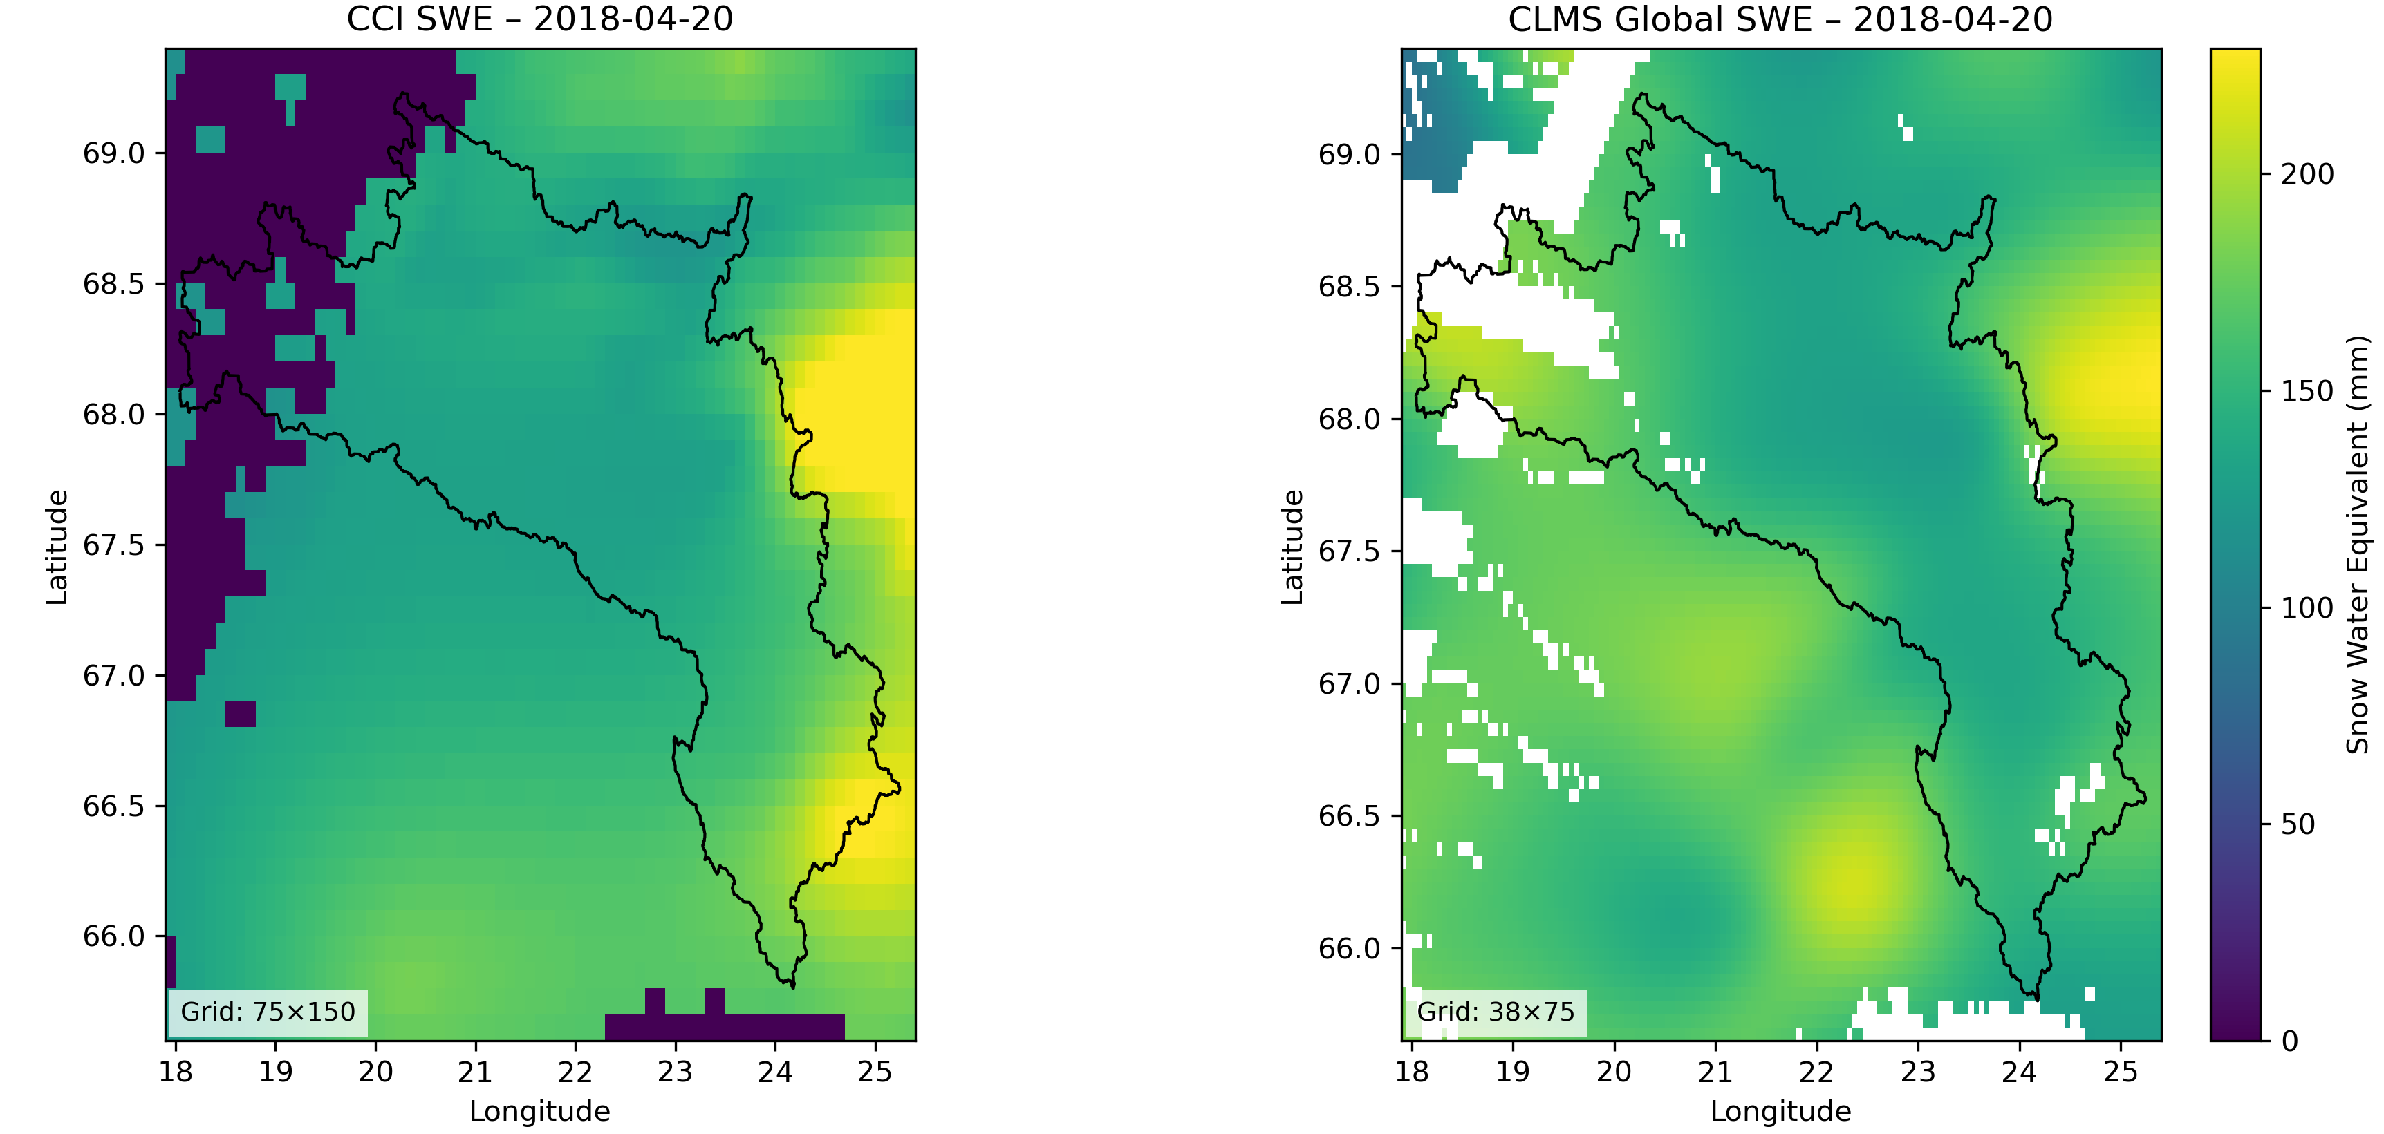
Snow
Products Portfolio – Snow Water Equivalent : Torne Basin
Both products are estimated (not directly observed) : modelling assumptions
In mountains : uncertainties are higher for both products
--> SWE values differ significantly in the same area, even if SCF look similar --> High impact on hydrology

Slide 37
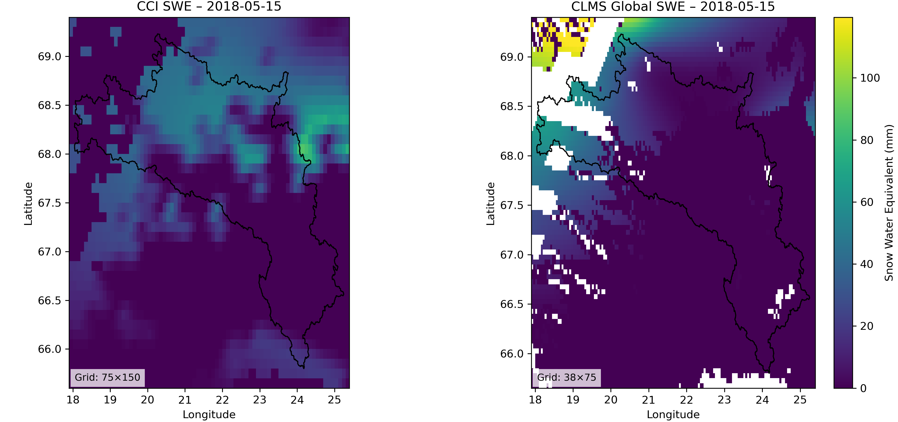
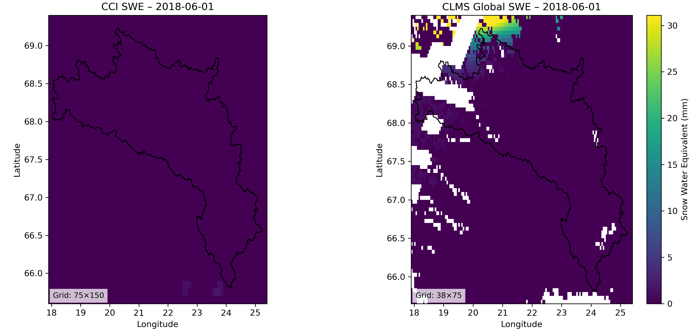
Snow
Products Portfolio – Snow Water Equivalent : Torne Basin

Slide 38
Snow
Products Delivery
 | Product |  | SP Code | Basins |  |  |  |  |  |  |  |  | Period
 |  |  |  | Torne | Danube | Rhine | Ebro | Po | Bra | Negro | Congo | Niger
CCI | SWE |  | CCI_SWE | x | x | x | x | x | x |  |  |  | 2016-2022
 | SCFG | MODIS | CCI_SCFG_MODIS | x | x | x | x | x | x
 |  | AVHRR Metop A | CCI_SCFG_AVHRR_METOPA | x | x | x | x | x | x
 |  | AVHRR NOAA 18 | CCI_SCFG_AVHRR_NOAA18
 |  | AVHRR NOAA 19 | CCI_SCFG_AVHRR_NOAA19
CLMS global | SWE |  | CLMS_SWE | x | x | x | x | x |  |  |  |  | 2016-2024
 | SCE | EU | CLMS_SCE_EUR | x | x | x | x | x |  |  |  |  | 2018-2024
 |  | NH | CLMS_SCE_NH | x | x | x | x | x | x
CLMS Europe | FSC |  | CLMS_FSC | x |  |  |  |  |  |  |  |  | 2016-2024
 | GFSC |  | CLMS_GFSC | x

Slide 39
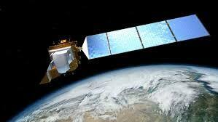
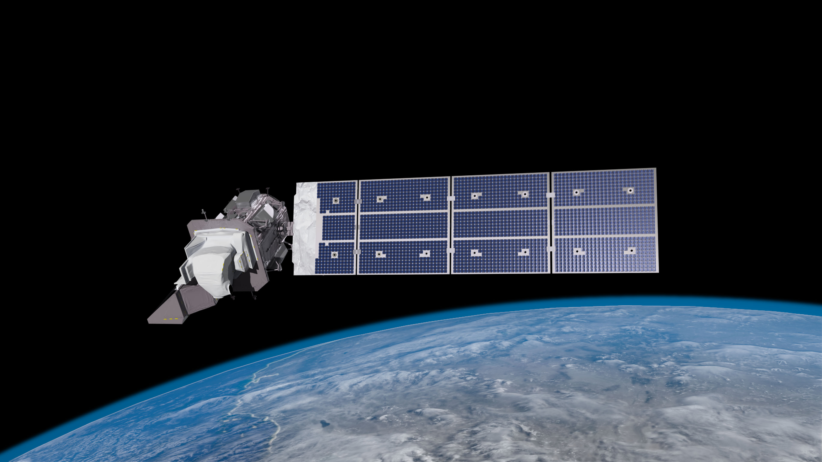
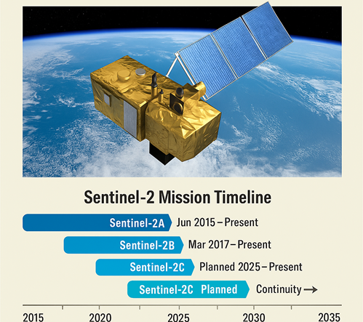
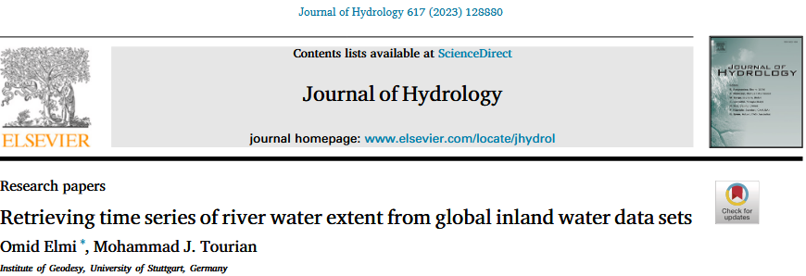
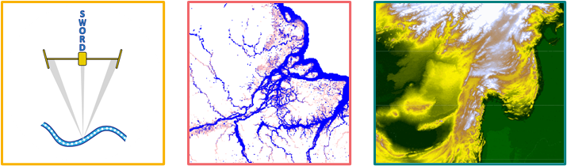
River Width
Automated workflow is developed to generate river reach water extent time series​ using satellite imagery:
Multi-spectral water indices:
NDWI: Normalized Difference Water Index
ANDWI: Automated Normalized Difference Water Index
NDMI: Normalized Difference Moisture Index
AWEI-sh: Automated Water Extraction Index - Shadow Version
AWEI-nsh: Automated Water Extraction Index - Non-Shadow Version
Landsat 8
2013- present
Landsat 9
2021- present
And auxiliary data like SWORD, GSW, FABDEM

Slide 40
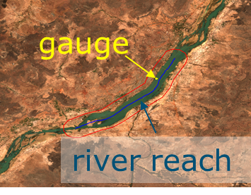
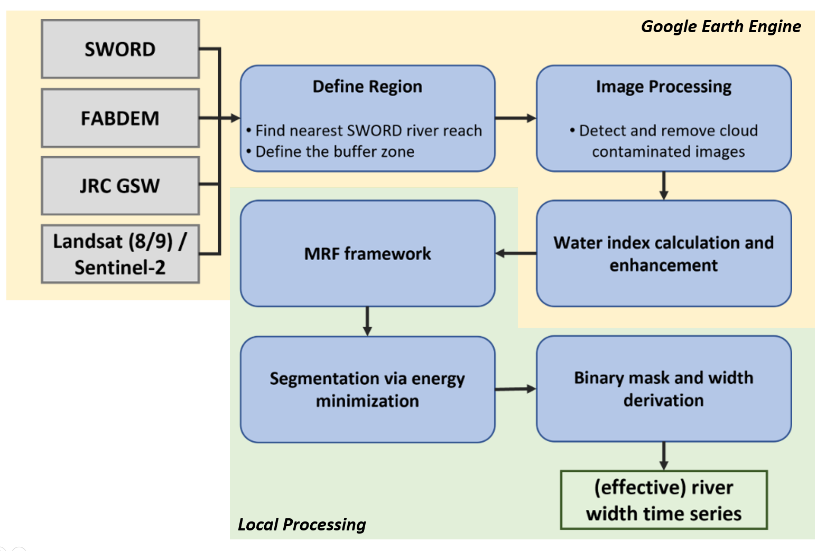
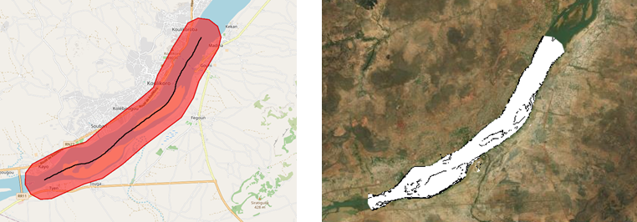
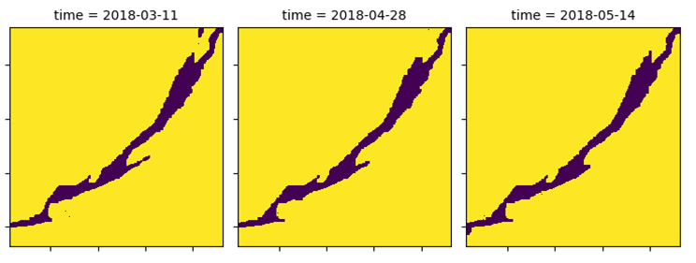
River Width
Automated tools are developed to generate river reach water extent time series​ using satellite imagery:

Slide 41
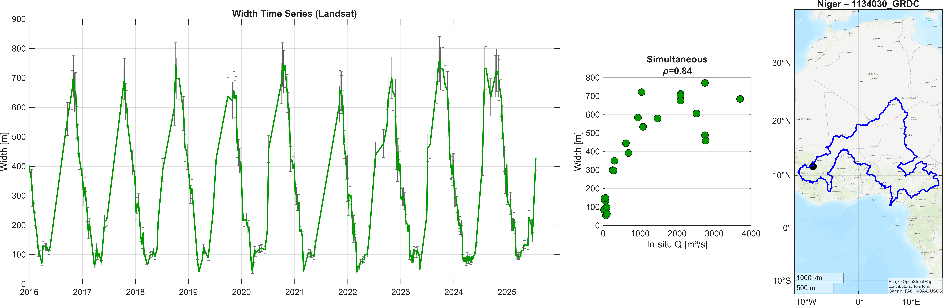
River Width
Examples: Landsat

Slide 42
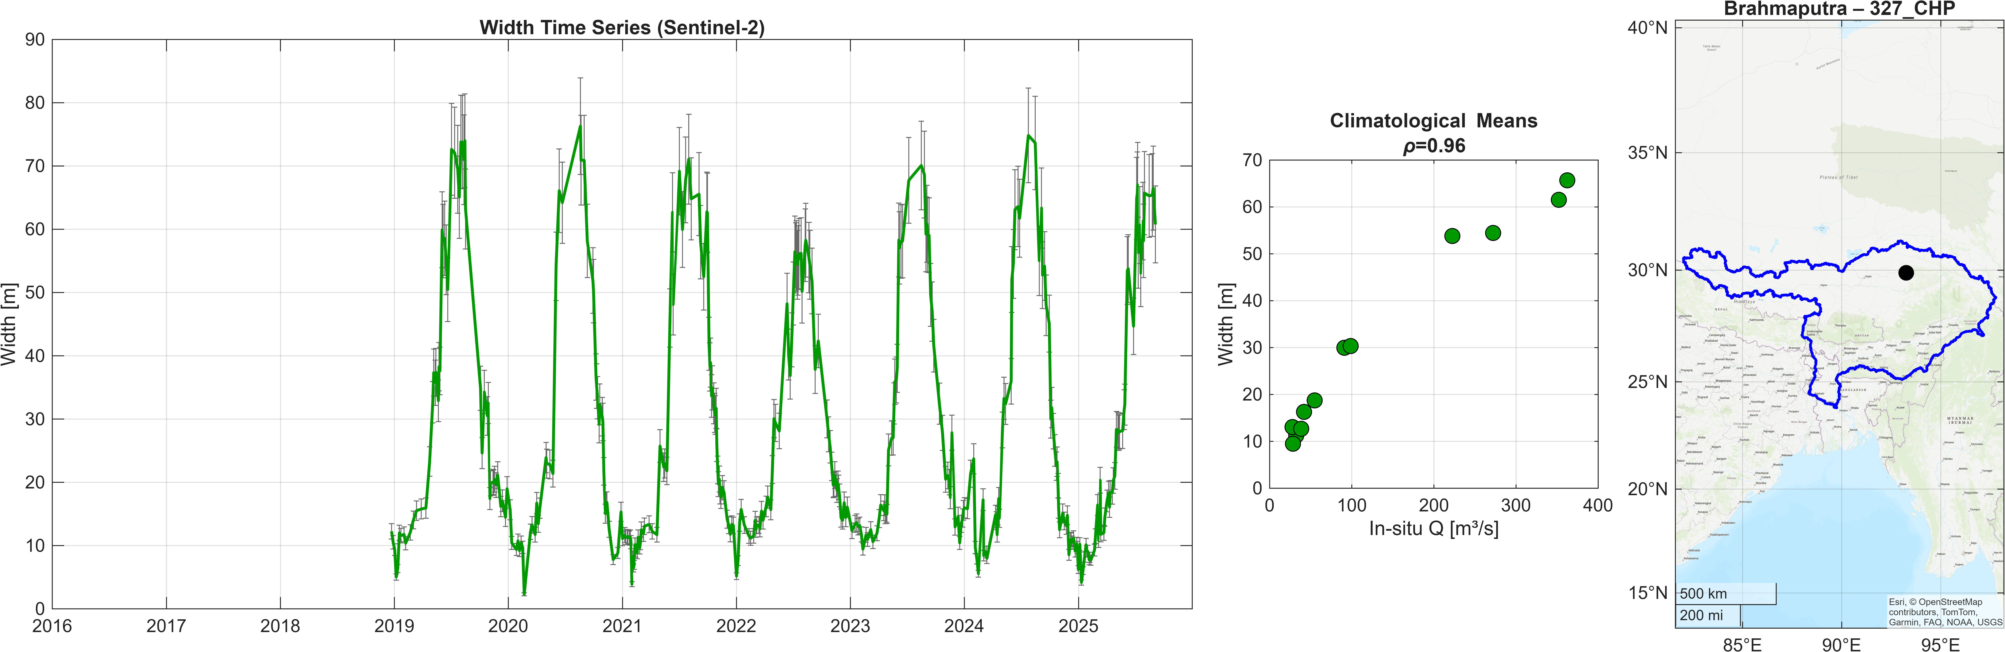
River Width
Examples: Sentinel-2

Slide 43
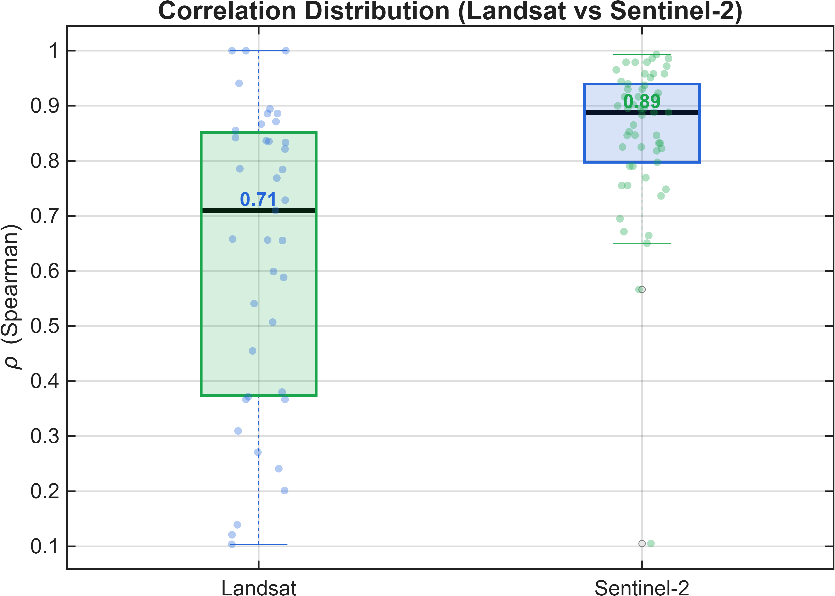
River Width
Correlation with insitu discharge:
Width time series from Sentinel-2 shows higher correlation (Only a couple of points fall below 0.6) with the in-situ river discharge.
Landsat has more scattered performance
The width time series are stored in NetCDF and CSV format under this folder in the sharepoint:
General\Shared_data\(basin)\12_width_timeseries

Slide 44
Reflectance Indices
Sensor | Temporal sampling | Spatial sampling | Temporal coverage | Status
MODIS Aqua | Daily | 250 m | 2016-2024 | Delivered
MODIS Terra | Daily | 250 m | 2016-2024 | Delivered
Sentinel-2 | 5-day | 10 | 2016-2024 | Delivered
Ancillary product | Temporal sampling | Spatial sampling | Temporal coverage | Source
Water mask | - | 30 m | 2016-2024 | JRC
Snow Mask | Daily | 1 km | 2016-2024 | MODIS
Cloud coverage | variable | variable | 2016-2024 | variable

Slide 45
Reflectance Indices
Algorithm
Kernels
Calibration
CM
CMW1
CMW2
CVM
CVMW1
CVMW2
Small
Large
Gauged site
Ungauged site
River discharge proxy from multispectral data
2
2
6

Slide 46
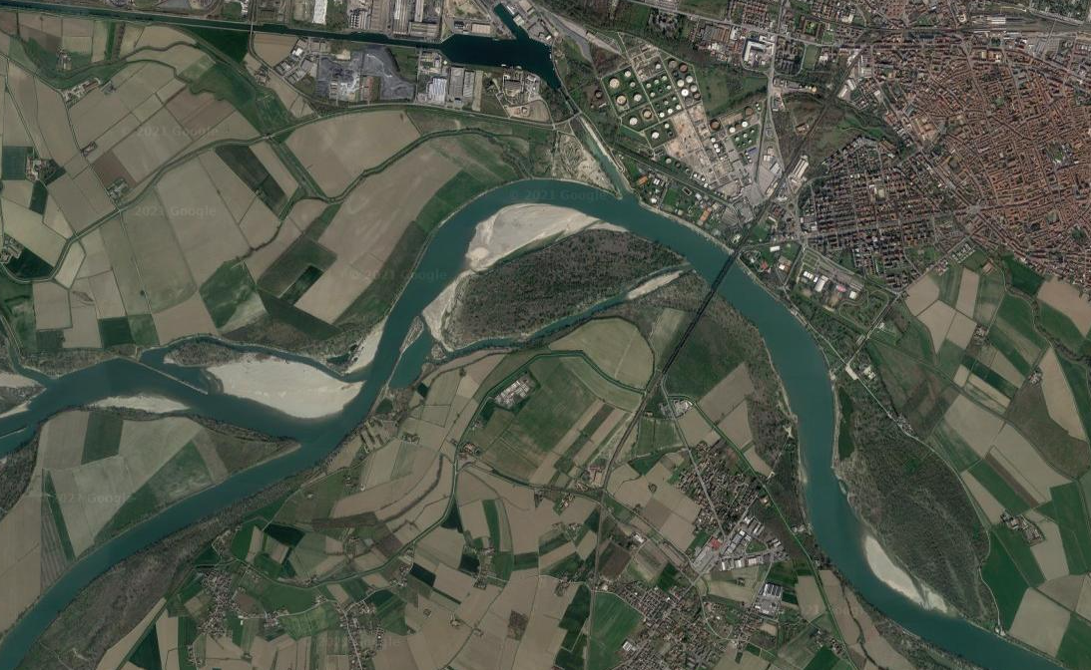





Reflectance Indices
Cities
Roads
$$⇒ C$$
Forest
$$⇒ V_{s}$$
Fields
$$⇒ V_{a}$$
Water
$$⇒ W$$
Water/Soil
$$⇒ M$$

Slide 47
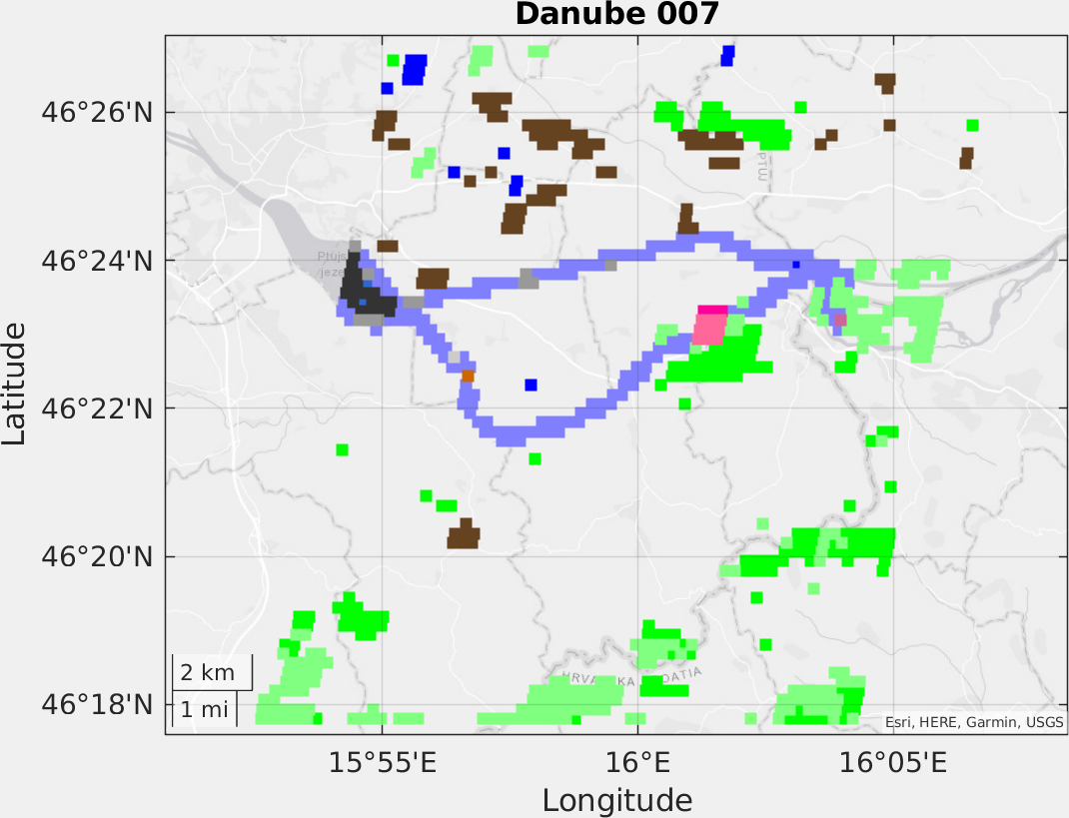
Reflectance Indices
Water bodies
River
Vegetation
Cult. fields
Stable areas
Uncal
M
Sediment

Slide 48



Reflectance Indices
S2 outperforms MOD and MYD thanks to the higher spatial resolution
Several peaks missed due to cloud coverage

Slide 49

Reflectance Indices
Performance scores obtained after calibration with observed data during the period 2016-2024

Slide 50


Reflectance Indices
CM algorithm calibration with WL data

Slide 51


Reflectance Indices

Slide 52

Reflectance Indices
C, M, W, V pixels selection;
Generation of several pixels combinations through bootstrapping;
Estimation of confidence interval.

Slide 53
Water Level
DAHITI Virtual Stations
Water level time series at virtual stations (VS) are provided by the Database for Hydrological Time Series of Inland Waters (DAHITI) through the DAHITI API and NetCDF files uploaded to the shared folder.
DAHITI comprises data from past LRM altimetry missions (e.g., Envisat, Jason-1/2), current SAR satellites
(e.g., Sentinel-3A/B, Sentinel-6A), and the novel wide-swath SWOT mission.
DAHITI applies common corrections for all altimetry missions, extended outlier detection, and Kalman filtering. Remaining biases between missions are removed through multi-mission cross-over analysis to derive combined long-term water level time series.

Slide 54

Water Level
DAHITI Virtual Stations
With the addition of SWOT, the virtual station density is significantly increased (see Germany/Sweden).
The number of stations increases steadily currently >19’300 VS globally

Slide 55


Water Level
DAHITI Virtual Stations
July 2025
November 2025
More than 561 VS were newly added to DAHITI within EO4FLOOD
Only Rivers, S3/S6 & SWOT:
1609 Stations
2170 Stations
Only Rivers, S3/S6:
1529 Stations
1822 Stations

Slide 56

Water Level
DAHITI Virtual Stations

Slide 57

Multi-mission water level and water surface slope
Workflow to prepare the input to the Multi-mission approach
Input
  Station list
  HydroBasin
  SWORD
  Nadir altimetry related to rivers
  Hydrocon to acquire SWOT RiverSP
Processes
  Intersection
  Data extraction
  Data filtering
  Merging
Output
  Altimetry projected to the river centerline along connected reaches around the station coordinate

Slide 58






Multi-mission water level and water surface slope
The Multi-mission model
Formulated as a state-space model
  Observations are assumed to follow a normal distribution
  The mean is defined a as Gaussian Markov Random Field (GMRF) + average slope + satellite-based bias
  The GMRF is an AR1 process in both the spatial and temporal dimension
Implemented via the R-package "RTMB" (fast minimization tool using automatic differentiation)
Model input
  Altimetry data file
  Dimension of grid solution (space x time)
  Model is run iteratively to ensure a more robust solution

Slide 59



Multi-mission water level and water surface slope
Overview
  Description of the products
  A demonstration over the Po Rivere
Two solutions are provided for each reach
A time series at the location of the gauge station
A grid solution; a time series at each 2 km along the reach

Slide 60


Multi-mission water level and water surface slope
Time series solution at the location of the gauge station

Slide 61

Multi-mission water level and water surface slope
A grid solution; a time series at each 2 km along the reach
Water elevation profile at a given time
WL time series at a given location(lon,lat/chainage)

Slide 62

Multi-mission water level and water surface slope
A grid solution; a time series at each 2 km along the reach
  Top surface elevation profile color coded as a function of tile
  Bottom: WL time series color coded as a function of chainage
Change of slope w.r.t time

Slide 63


Multi-mission water level and water surface slope
Example with a narrow Ebro River (width 100-200m)
  A limited amount of data prior to SWOT
  Almost non before ICESat-2

Slide 64

Multi-mission water level and water surface slope
Example with a narrow Ebro River
  The reconstructed time series has a limit resolution prior to SWOT
  Based on the mean temporal resolution the time step size is here ~20 days, could be ~7 days if only the SWOT period is used

Slide 65

Multi-mission water level and water surface slope
Example with a narrow Ebro River
  The reconstructed time series has a limit resolution prior to SWOT
  Based on the mean temporal resolution the time step size is here ~20 days, could be ~7 days if only the SWOT period is used
Effect due to a limited data coverage

Slide 66

Multi-mission water level and water surface slope
WSS around gauge station
  Take the difference between 2 time series around the gauge
  Make a linear regression of x water level time series around the gauge
  Model slope directly
  To calculate the slope must re-run the models
Summary: Multi-mission approach
  Can use altimetry with a geodetic orbit
  Works best for single channel rivers
  Fails if the reach is short or to little data is available

Slide 67

River Discharge
Estimating river discharge at the selected gauges:
A : River discharge from multimission water level, width, and reflectance time series at the location of the selected gauges
B: Merged river discharge from all the above-mentioned sources (observations) at the location of the selected gauges

Slide 68



River Discharge
(A): River discharge from multimission water level, width, and reflectance time series at the location of the selected gauges

Slide 69

River Discharge
(A): River discharge from multimission water level, width, and reflectance time series at the location of the selected gauges

Slide 70

River Discharge
(A): River discharge from multimission water level, width, and reflectance time series at the location of the selected gauges

Slide 71


River Discharge
(A): River discharge from multimission water level, width, and reflectance time series at the location of the selected gauges
To merge different reflectance products, we follow the approach introduced in:
Filippucci, P., Sahoo, D. P., & Tarpanelli, A. (2025). Two decades of river discharge from multi-mission multispectral data. Remote Sensing of Environment, 329, 114919.

Slide 72

River Discharge
(B): Merged river discharge from all the above-mentioned sources (observations) at the location of the selected gauges
Remove cases with KGE<0.2

Slide 73

River Discharge
(B): Merged river discharge from all the above-mentioned sources (observations) at the location of the selected gauges

Slide 74

River Discharge
Accepted merged discharge
Rejected merged discharge

Slide 75

River Discharge
(B): Merged river discharge from all the above-mentioned sources (observations) at the location of the selected gauges
Basin | # Merged Q | # No Merged Q | # Total
Bramhaputra | 15 | 6 | 21
Congo | 18 | 5 | 23
Danube | 42 | 4 | 46
Ebro | 21 | 14 | 35
Negro | 25 | 0 | 25
Niger | 33 | 14 | 47
Po | 28 | 10 | 38
Rhine | 25 | 19 | 44
Torne | 15 | 22 | 37
The discharge time series are stored in NetCDF and CSV format under this folder in the sharepoint:
General\Shared_data\(basin)\15_River_Discharge

Slide 76

River Discharge
(B): Merged river discharge from all the above-mentioned sources (observations) at the location of the selected gauges
Multi-mission satellite altimetry provides the highest overall discharge performance, followed by width- and reflectance-based approaches.
The merged product provides a stable, integrated performance across all observables, with outlier rejection mainly suppressing extreme cases.
Note: In cases where no temporal overlap exists between estimated discharge and gauge records, the comparison is based on mean monthly discharge values.
We are drafting a manuscript that evaluates discharge estimates obtained from individual EO-based approaches and from their merged discharge product.

Slide 77

River Discharge
Ungauged Rivers
Purely EO-based approach (no in-situ data)
water level from radar altimetry
river width from high-resolution satellite images
water surface slope from laser altimetry
bathymetry from hypsometry (width by water level)
& empirical width-to-depth function
River discharge is derived at multiple consecutive
cross-sections per reach
Roughness coefficient is optimized by minimizing the discharge differences between the cross-sections
Includes uncertainties

Slide 78

River Discharge
Ungauged Rivers
36 Stations were processed
Data is available (CSV and NetCDF) in the River_Discharge_Ungauged folders
The files contain a comment on expected data quality, judging from the processing
Stations were selected with focus on ungauged (sub-)basins such as Brahmaputra, Congo, and Niger
14 Stations were selected in the Rhine, Danube, Ebro, and Po basins for validation and intercomparison with the calibrated approaches.

Slide 79


River Discharge
Ungauged Rivers – Example: Po River

Slide 80


River Discharge
Ungauged Rivers – Small Example: Mures River (Danube Basin)

Slide 81


River Discharge
Ungauged Rivers – High-Uncertainty Example: Danube River

Slide 82
Flood Extent
FLOOD EXTENT (Tailored products for EO4FLOOD, Requirements & Tasks Status)
REQUIREMENTS | STATUS
Provision of AOIs | ✅
Provision of past flood events dates (to EO data extraction) | ✅
Provision of hydraulic models’ temporal & spatial resolution | ✅
Provision or information on DEM used by models (FathomDEM) | ✅
Confirmation on ideal EO flood mapping temporal and spatial resolution | ✅
TASKS | STATUS
Identification of the requirements needed for each (hydraulic model) requirements: Congo, Negro, Niger, Brahmaputra, Torne. | ✅
Collection of EO raw datasets (S1, S2 and VIIRS) | ✅
Test local conditions in AOIs, sensors, & assessments of which sensor used in each AOI | ✅
Flood extent & metadata production, QA review, and delivery for each AOI | ✅
Transformation from Tiff to Cloud Optimised Geotiffs (COGs) and compression algorithm application | ✅
Metadata production compliance with ESA Open Data Catalogue (STAC) | ⏳

Slide 83

Flood Extent
FLOOD EXTENT: is being derived from 3 different sensors and for specific events
AOI | Event dates [2019-2024] | S1 (+/-12days,VH+VV, variable frequency) | S2 (+/- 5days) | VIIRS (+/- 5days, daily data)
Congo | 12/12/2022 & 11-12/01/2024 | 6 (3 full coverage, 3 partial coverage) | 3 images, very cloudy | 23 images
Negro | 16/06/2021 & 10-19/05/2022 | 13 (8 full coverage, 5 partial coverage) | 19 images | 31 images
Niger | 21/01/2019 (Tillaberi), and 01/09/2019 (Niamey), 15/09/2020, 26/08/2022 & 22/08/2024 | 30 (partial coverage) | 65 images | 55 images
Brahmaputra | 30/06/2020 & 10/10/2024 | 8 (full coverage) | 3 images, very cloudy | 22 images
Torne | 17-26/05/2024 | 13 (full coverage) | 13 images | 33 images
Summary: 12 flood events across 5 river basins, 337 satellite images analysed (S1 with partial AOI coverage, potential miss max flood peak)
Local conditions are very different in each river basin, such as the color and appearance of the flood water.
S1 & VIIRS [downscaled] provided at 30m (DEM res), and S2 at 10m.

Slide 84

Flood Extent
Methodology VIIRs

Slide 85





Flood Extent
VIIRS flood mask downscaling
HydroRivers/HydroLakes
VIIRS flood maps (e.g. 15/01/2020)
Downscaling
(375 to 30m)
FathomDEM 30 m
Height Above Nearest Drainage (HAND)
HAND

Slide 86

Flood Extent
Methodology S1
AOI | Threshold | Reference dry period
Torne | Band VH: 0.70 Band VV: 1.29 | 20220901-20221101
Negro | Band VH: 0.59 Band VV: 1.41 | 20230901-20231101
Niger | Band VH: 0.70 Band VV: 1.36 | 20221101-20230601
Congo | Band VH: 0.68 Band VV: 1.29 | 20240601-20240901
Brahmaputra | Band VH: 0.60 Band VV: 1.32 | 20201201-20210501

Slide 87







Flood Extent
Sentinel-1 pre-processing
S-1 Method 1: Deviation-based
Track 21
Track 123
Remove images affected by disclaimers
Remove border noise
Resample to 30 m
Define the reference conditions by track
Detect floods as a departure from reference conditions based on per-basin thresholds:
Reference Mosaic
AOI | Threshold | Reference dry period
Torne | Band VH: 0.70 Band VV: 1.29 | 20220901-20221101
Negro | Band VH: 0.59 Band VV: 1.41 | 20230901-20231101
Niger | Band VH: 0.70 Band VV: 1.36 | 20221101-20230601
Congo | Band VH: 0.68 Band VV: 1.29 | 20240601-20240901
Brahmaputra | Band VH: 0.60 Band VV: 1.32 | 20201201-20210501
By-orbit counts
Border noise
Multi-orbit %

Slide 88

Flood Extent
FLOOD EXTENT → Sample map for the 15/09/2020 flood event in Niger River basin
Sentinel-1
VIIRs 5-day composite

Slide 89

Flood Extent
Methodology S2
Bands | Description
Band 1 | Other land cover types
Band 2 | Water
Band 3 | Clouds
Map reformatted to COG
Value | Description
1 | Other land cover types
2 | Water
3 | Clouds

Slide 90

Flood Extent
FLOOD EXTENT → Sample map for the 15/09/2020 flood event in Niger River basin
Sentinel-2

Slide 91



Flood Extent
STAC Catalogue first test
NEXT STEPS: PUBLIC DATA DELIVERY
Upload data in public bucket
Temporary upload & test done in a GMV’s bucket, but requires EO4FLOOD Zenodo/bucket
STAC Metadata production:
For S1 + VIIRS: STAC metadata implemented with default fields (Additional fields to be tested + Requires link to EO4FLOOD Zenodo/bucket)
API link between bucket and ESA Open Science Catalogue:
GMV tested using another catalogue. Requires EO4FLOOD Zenodo and API connection to ESA Catalogue
Subcatalogue of Flood extent (S1)
(5 basins)
Collection of Flood extent (S1) per basin
Assets: individual datasets (flood maps)

